Slide 1
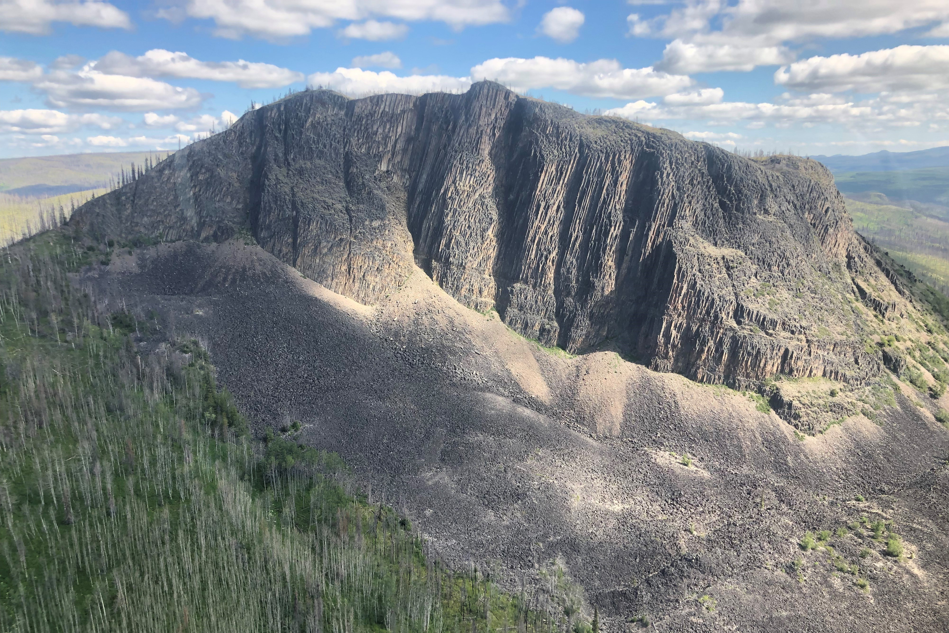
Nechako Reservoir / River / Freshet Information Sharing –
Community Leaders
4 January 2023
Prepared by Andrew Czornohalan & Simon Matte

Slide 2
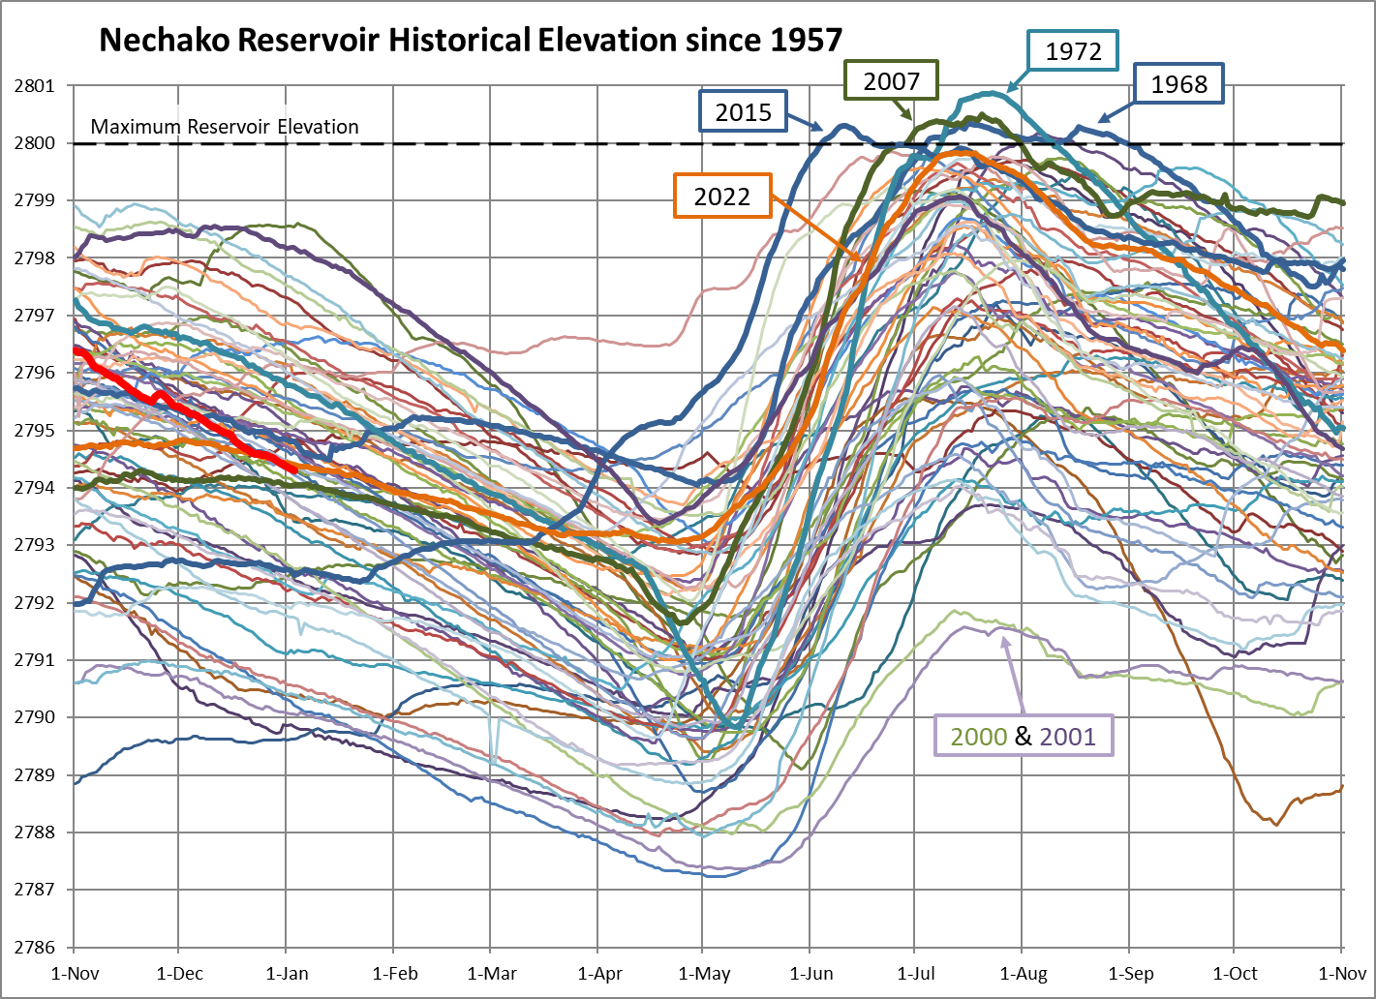
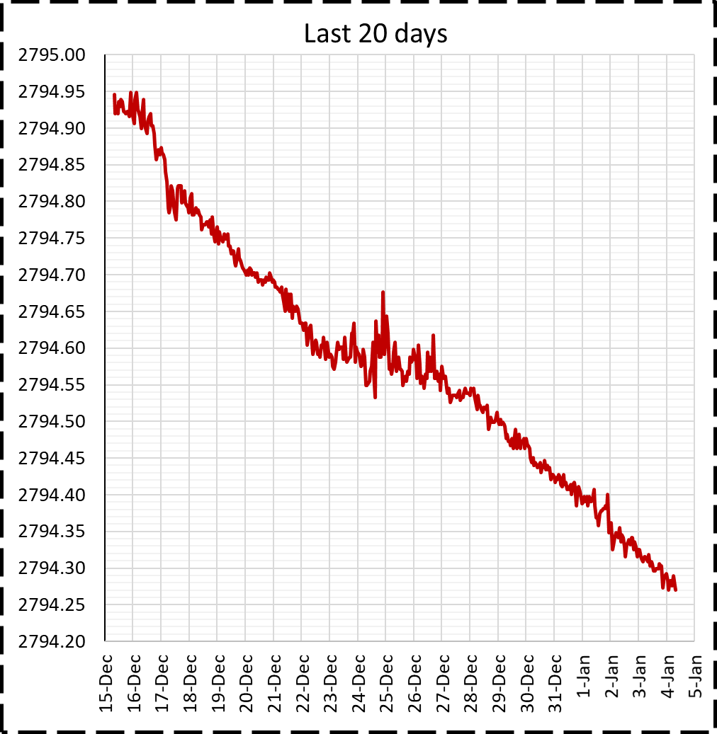
Reservoir Elevation - Last 20 days
Current reservoir level:
2794.27 ft

Slide 3
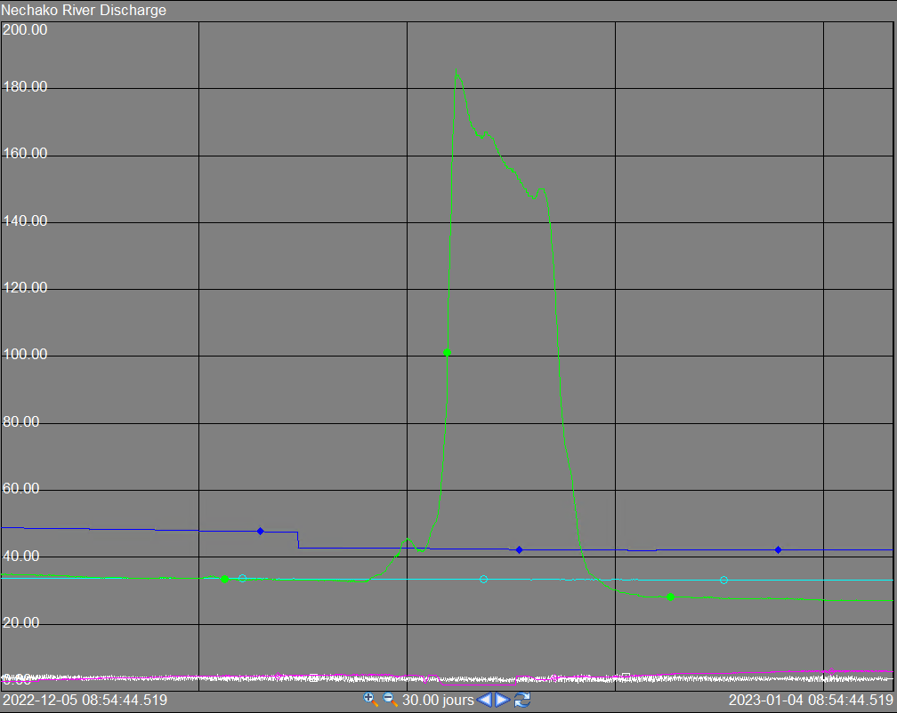
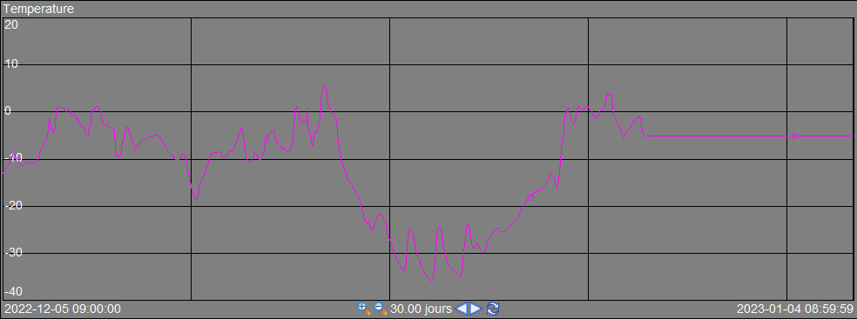
Flows - Last 30 days
Current values (m³/s)
Vanderhoof | 42*
Skins Lake | 33
Cheslatta Falls | 27*
Nautley | 6
Stellako | 4
*Provisional values due to ice effects

Slide 4
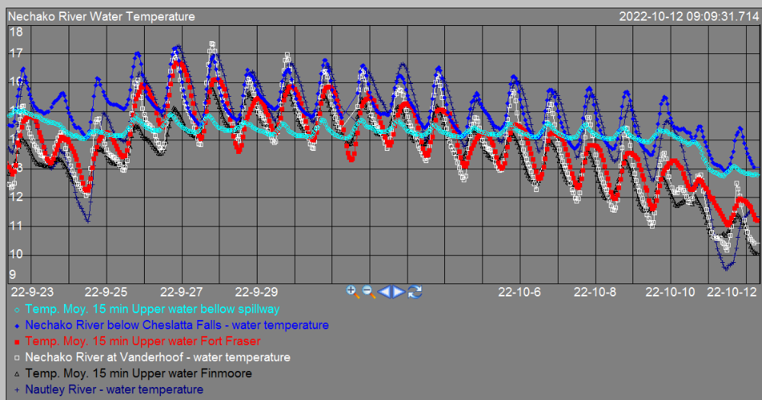
Observed Water Temperatures – Last 20 days
Current values (°C)
Upper water below spillway | 12.8
Nechako River below Cheslatta Falls | 13.1
Upper water Fort Fraser | 11.2
Nechako River at Vanderhoof | 10.4
Upper water Finmoore | 10.1
Nautley River | 11.3

Slide 5
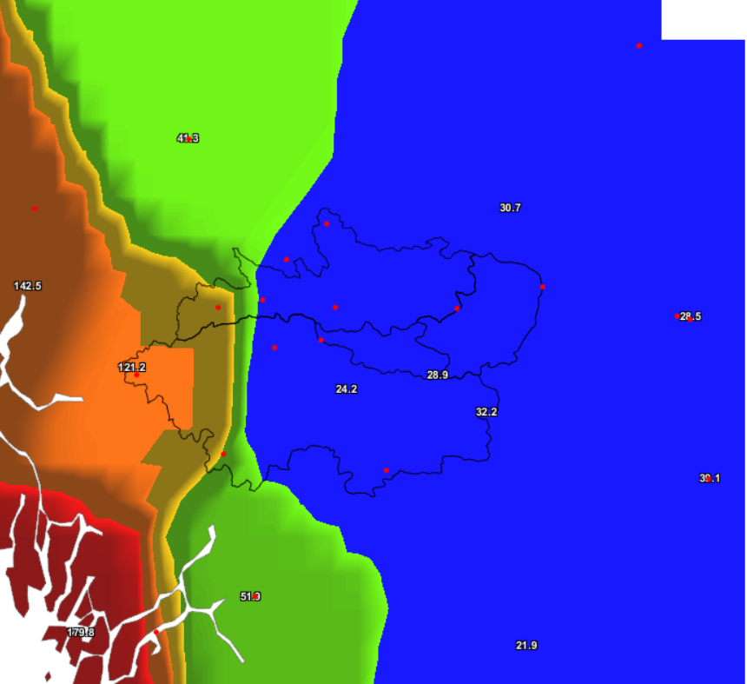
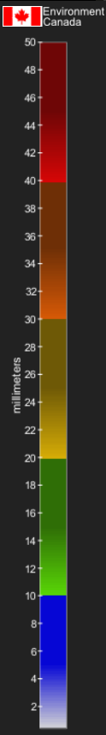
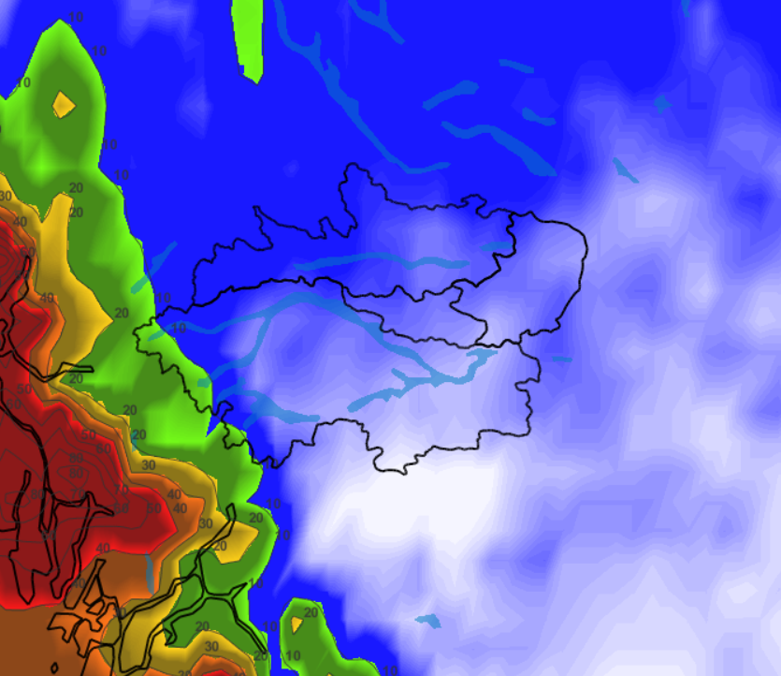
Past & Future cumulative precipitation
Observation (last month)
Forecast (next week)
Nechako Reservoir watershed area-average = 67 mm
Nechako Reservoir watershed area-average = ~5 mm
Notes:
As much rain over the last week as we've received over the previous 3 months (July 26th to October 25th)

Slide 6
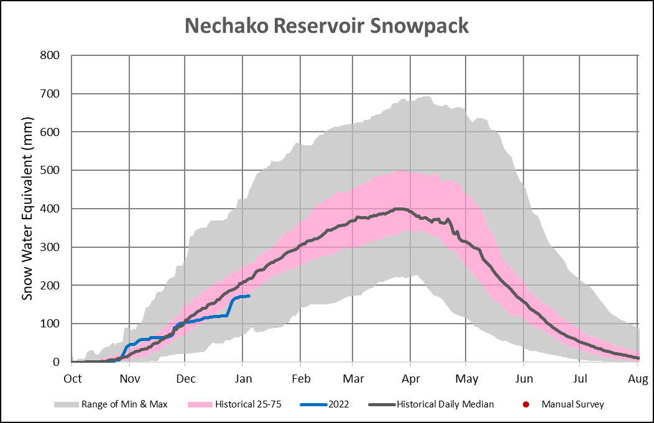
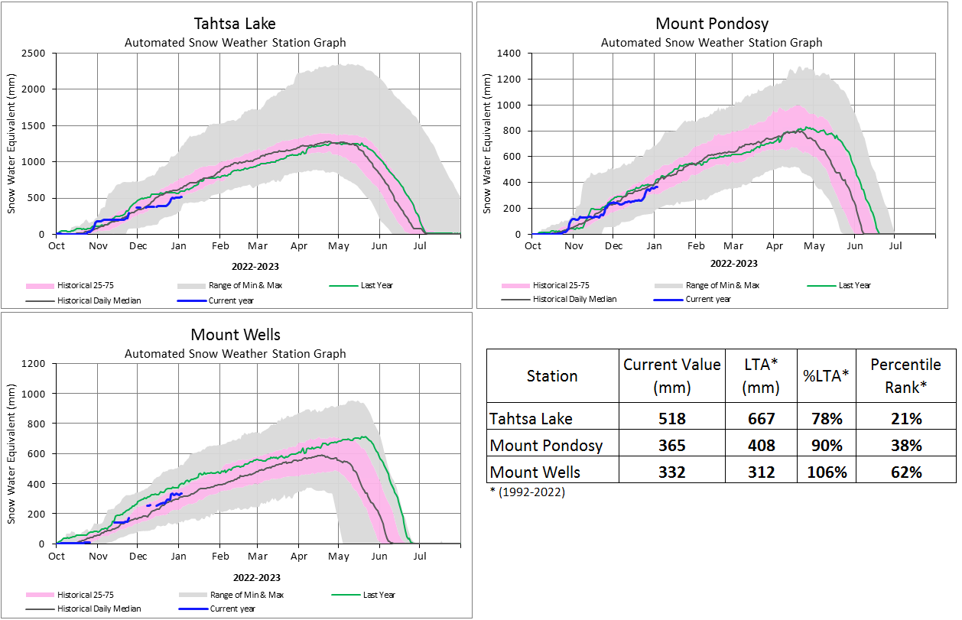
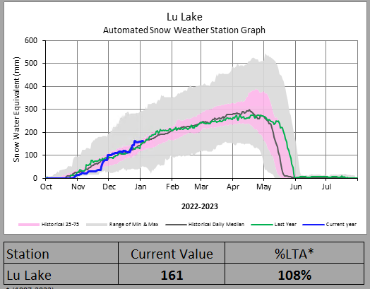
Current Snowpack
173 mm (75% LTA; 53rd/64)

Slide 7
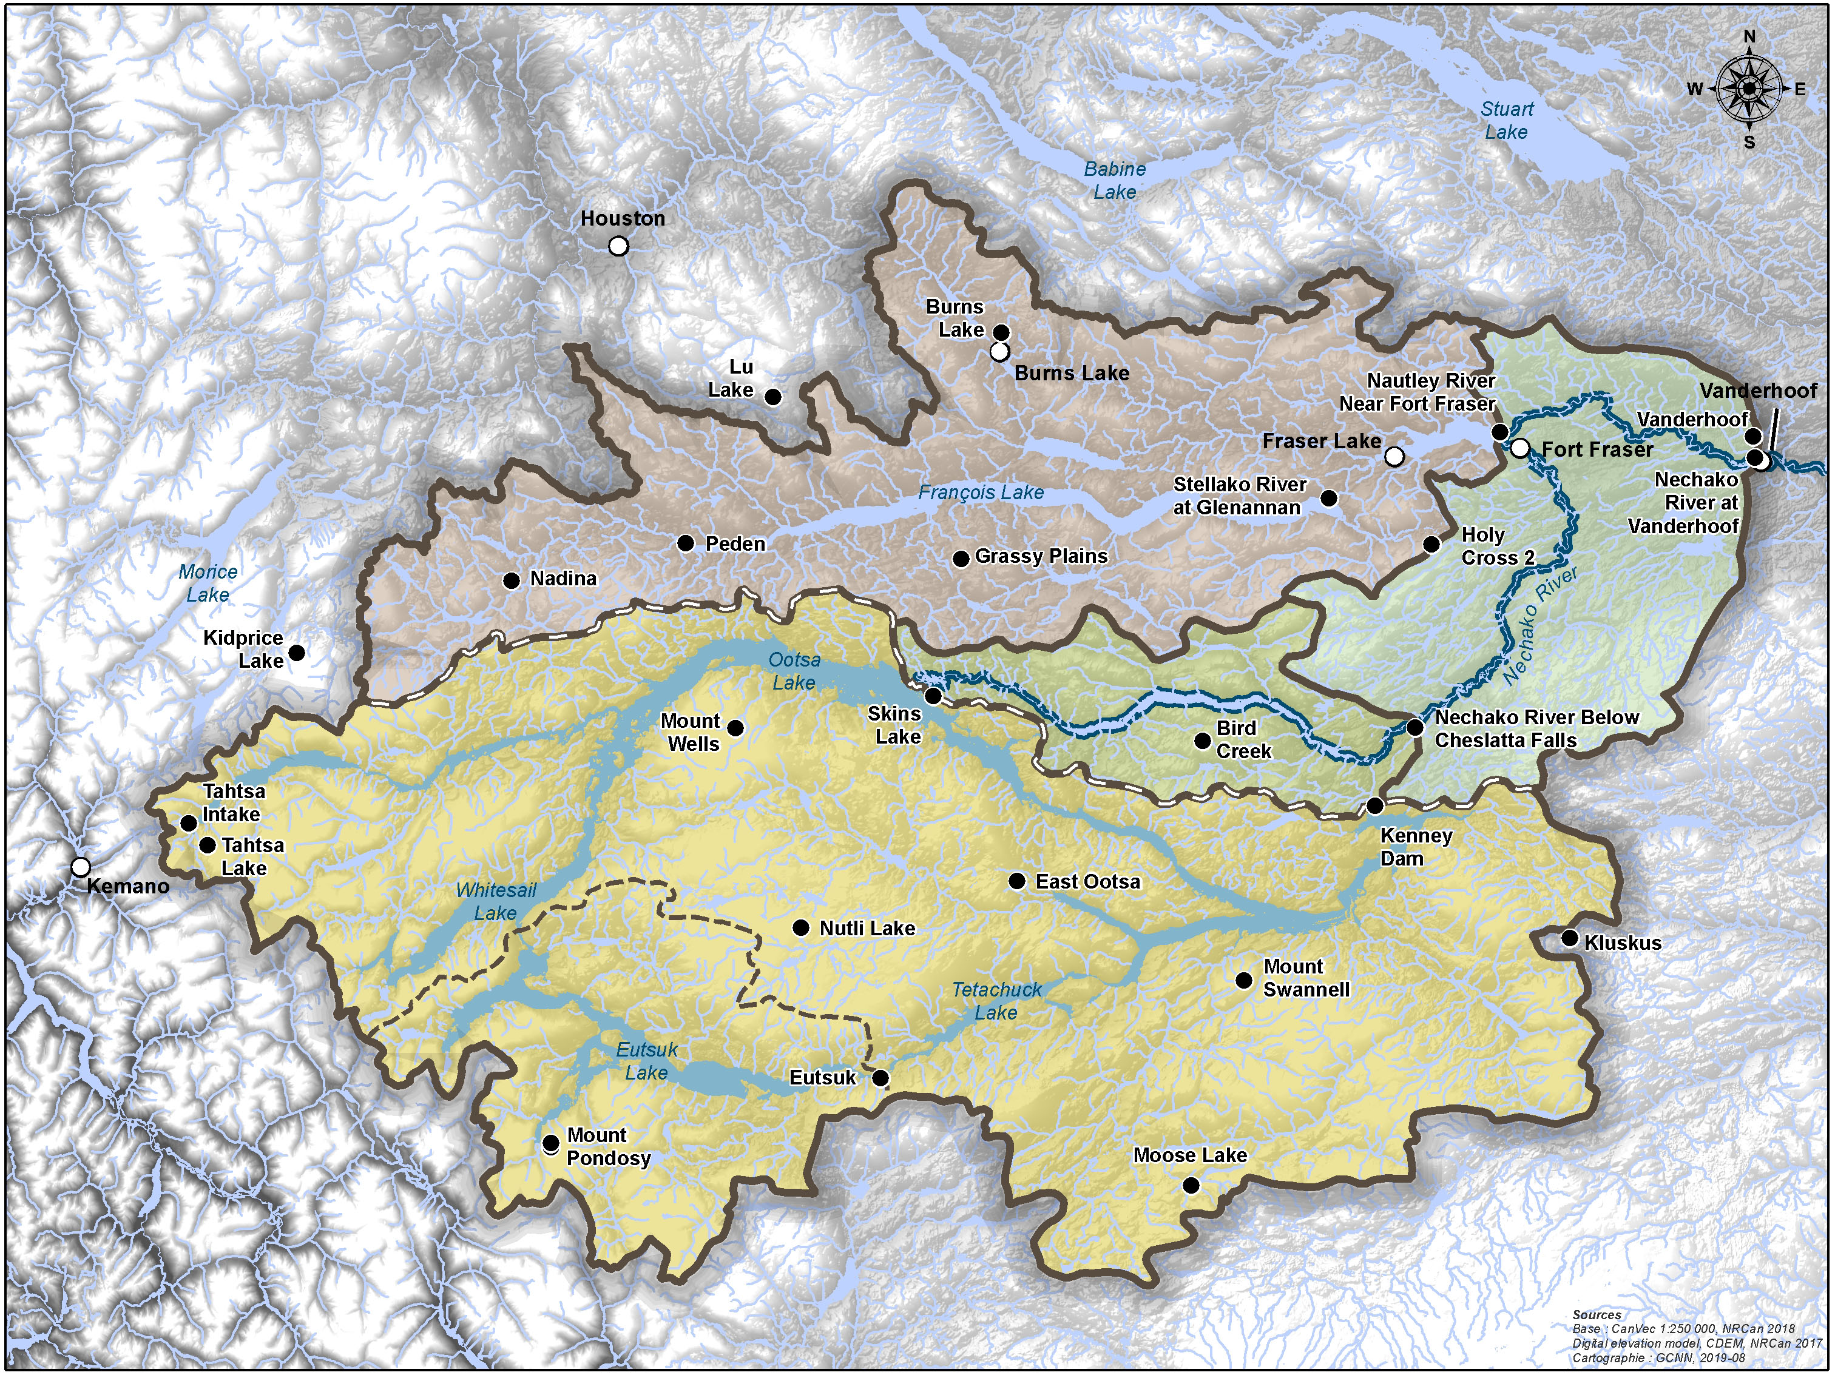
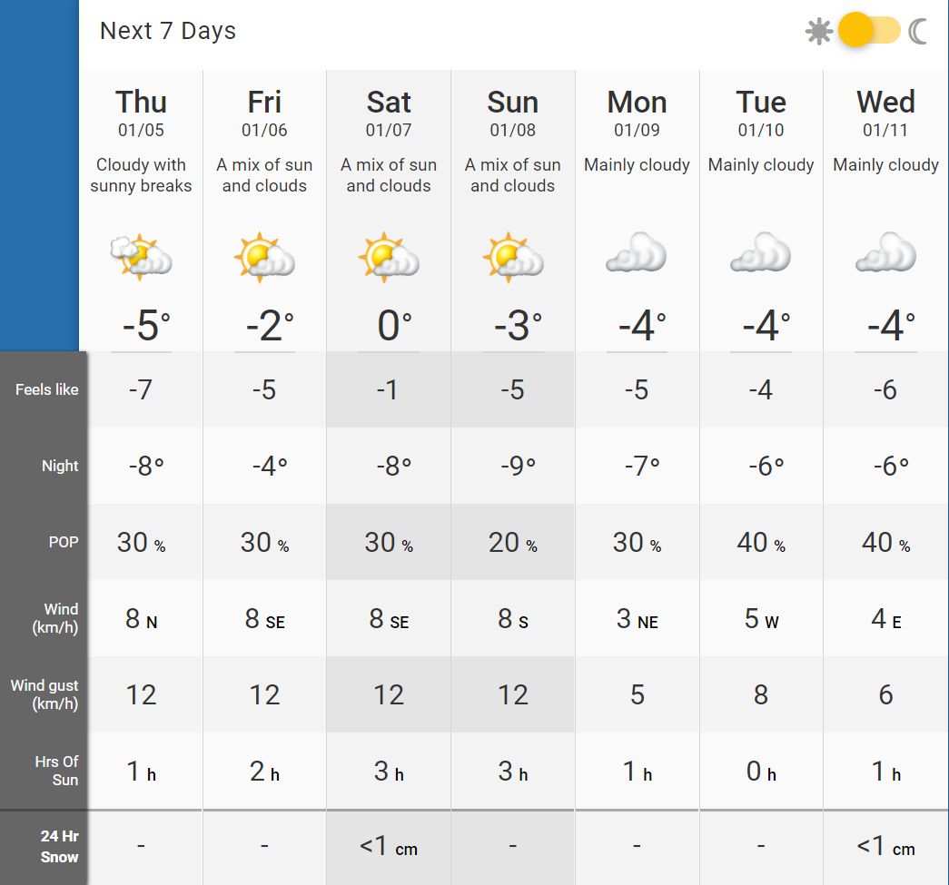
Weather Forecast
Marilla Weather
Marilla

Slide 8
Weather Forecast*
Burns Lake Weather
McDonalds Landing
Streatham
Baptiste Louis 8
Marilla
Targe Creek
Leon 14
*Possible Weather Stations
Nechako Reservoir
Kemano
Streatham
Marilla
Leon 14
Nechako River
Vanderhoof
Cheslatta
Baptiste Louis 8
Targe Creek
Nautley
McDonalds Landing
Burns Lake
Fraser Lake

Slide 9
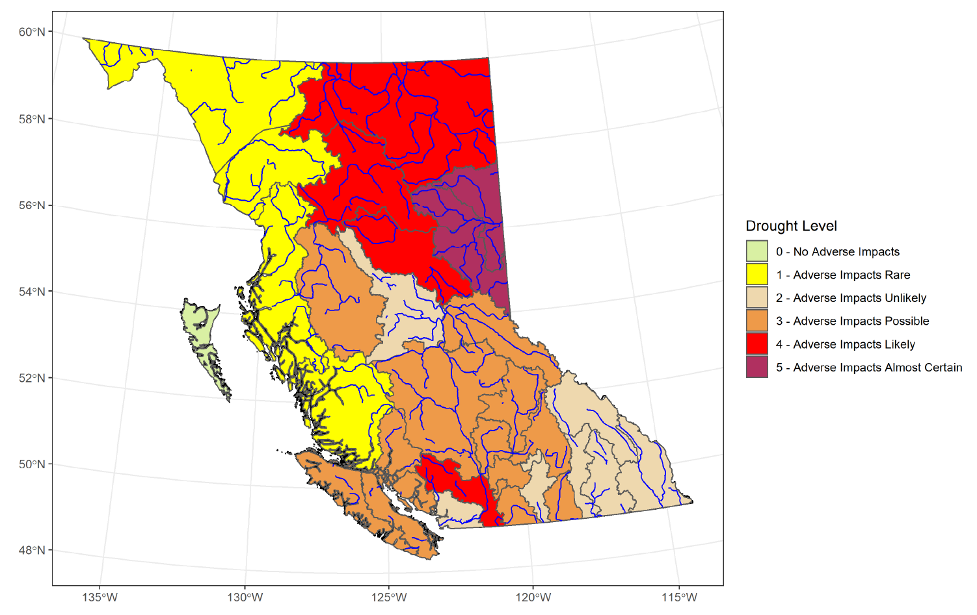
Provincial Drought Advisories
Last updated : December 1st
Drought updates have concluded for the 2022 season and will resume in spring 2023.
Source: British Columbia Drought Information Portal
Water Management Branch – Ministry of Forests

Slide 10
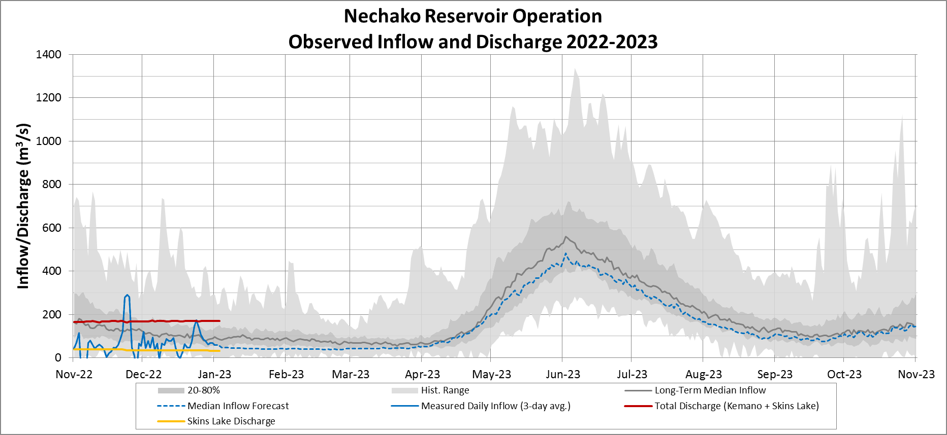
Observed Inflows & Discharge vs Historical

Slide 11
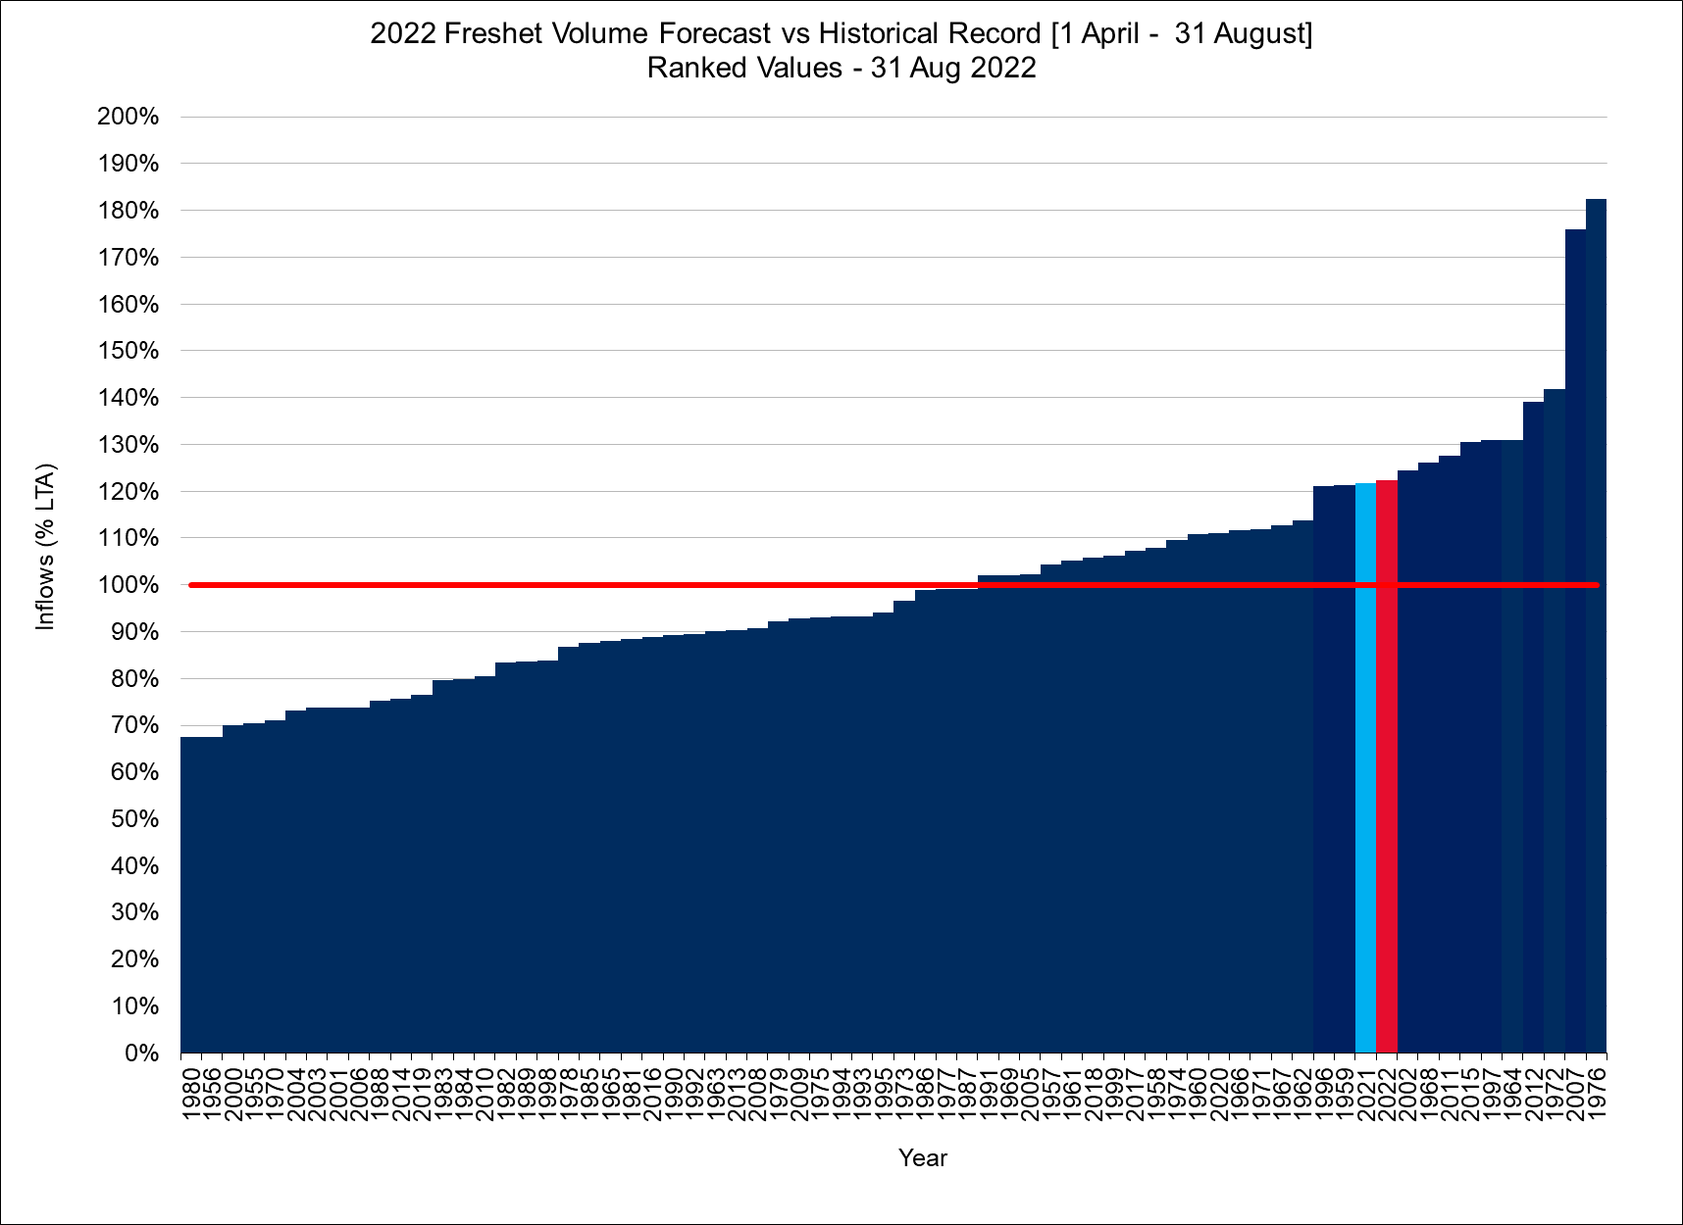
Spring Freshet Inflow Volume
Historical Record of Observed Volumes
Forecast Volume Exceedance Probability
Forecast Volume Average
122% LTA
Last year

Slide 12
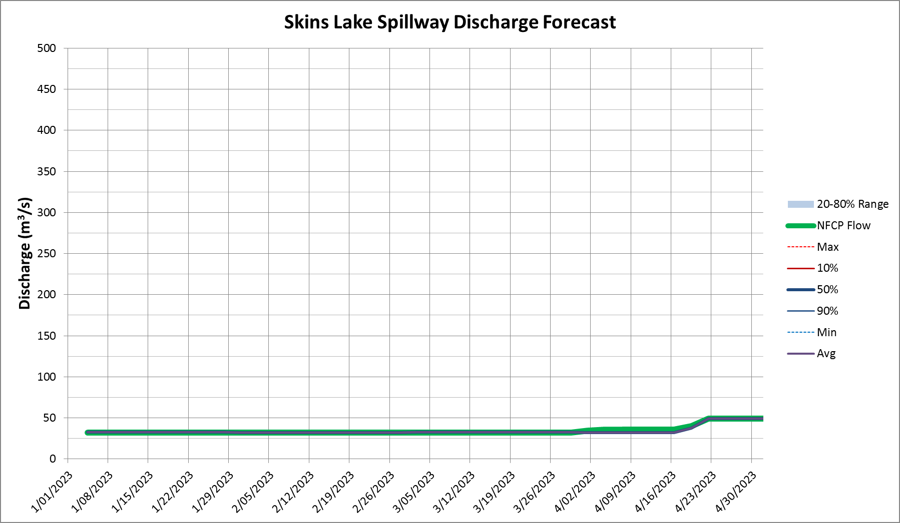
Skins Lake Spillway Release Forecast
Last gate change (November 23rd) = 34 m³/s
Current = ~33 m³/s
Winter minimum = 32 m³/s

Slide 13
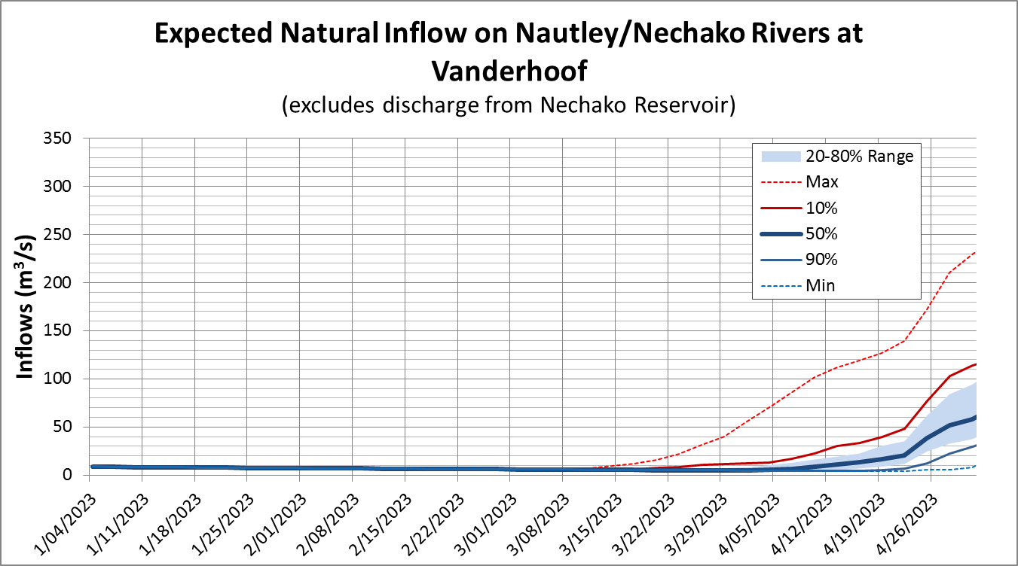
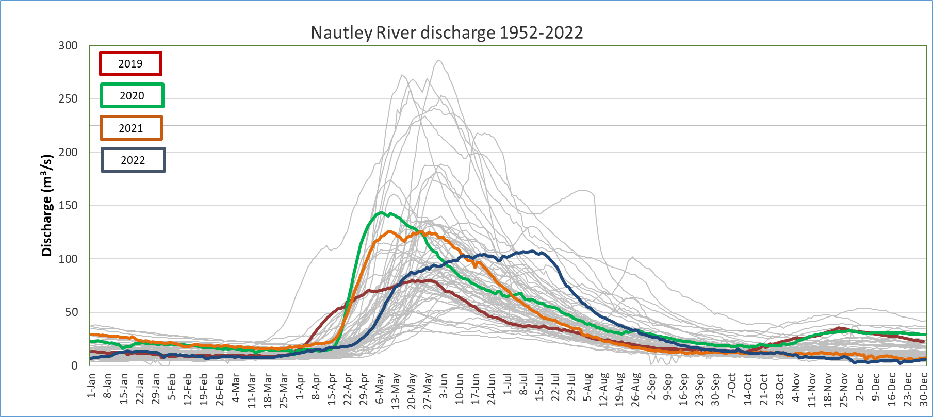
Nautley River Flows, Forecast

Slide 14
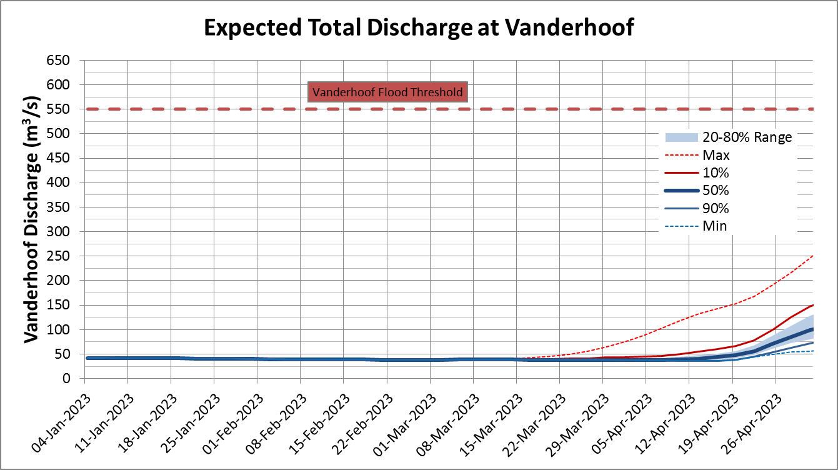
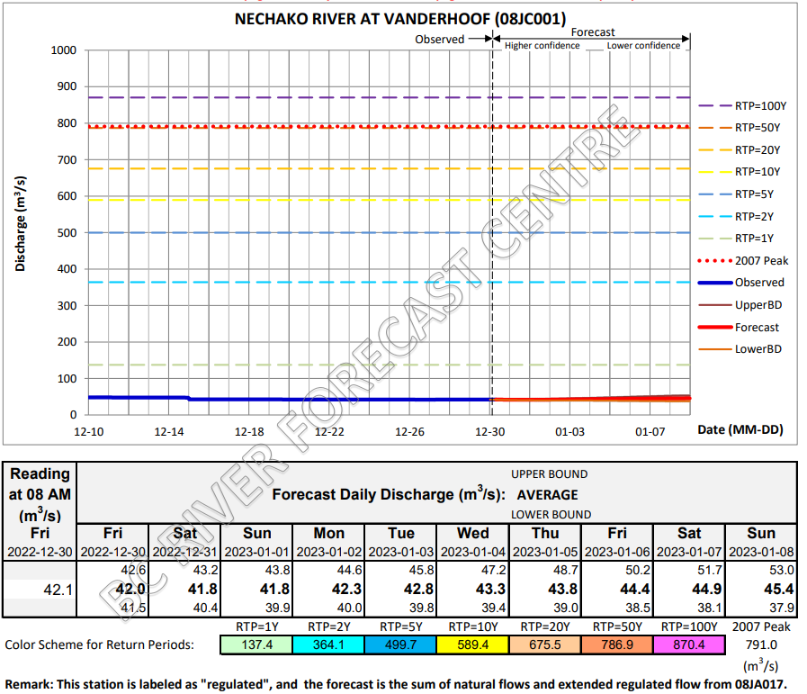
Forecast – Vanderhoof

Slide 15
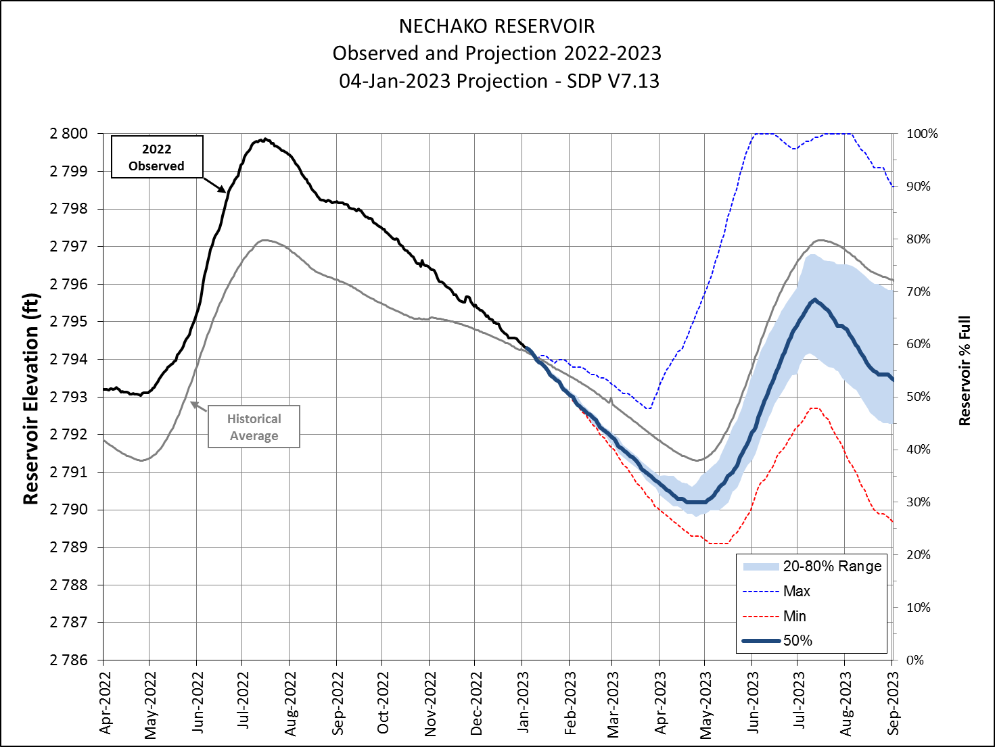
Reservoir Level Projection

Slide 16
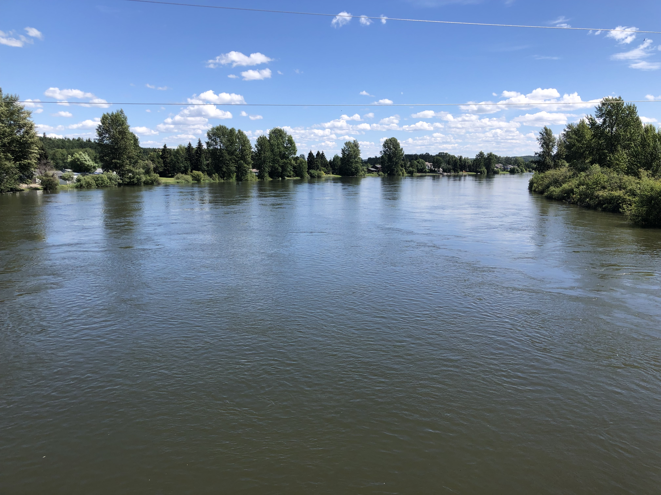
Next Steps – Actions
Model update and communications.
Monitoring work to learn from 2022 release
Continue to update on Smelter Re-Start
Confirm next meeting date & time – Propose
(4w) February 1st.
(5w) February 8th.
Presentations are available on the Get Involved Nechako website under 'Our Operations'. Recordings can be requested up to 30 days following the meeting.

Slide 17
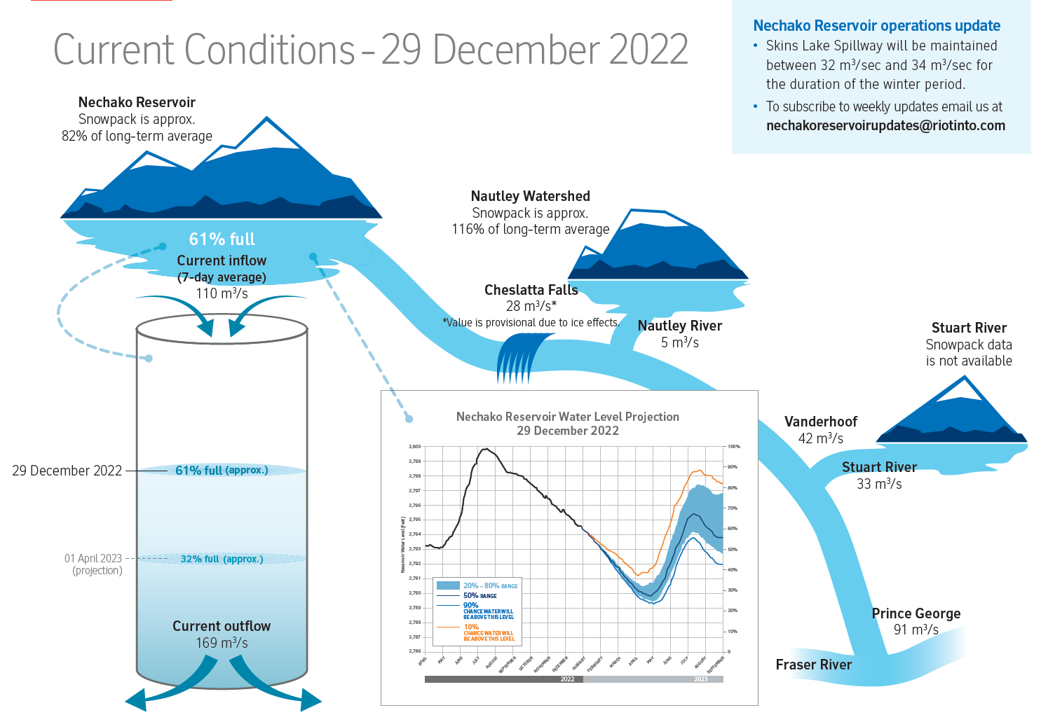
Flow facts of last Thursday

Slide 18
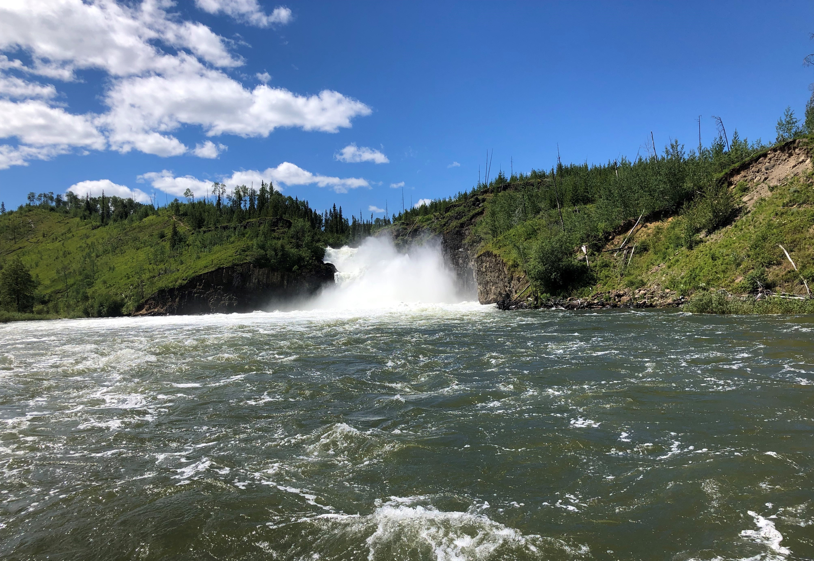
Feedback & Reflections

