Slide 1
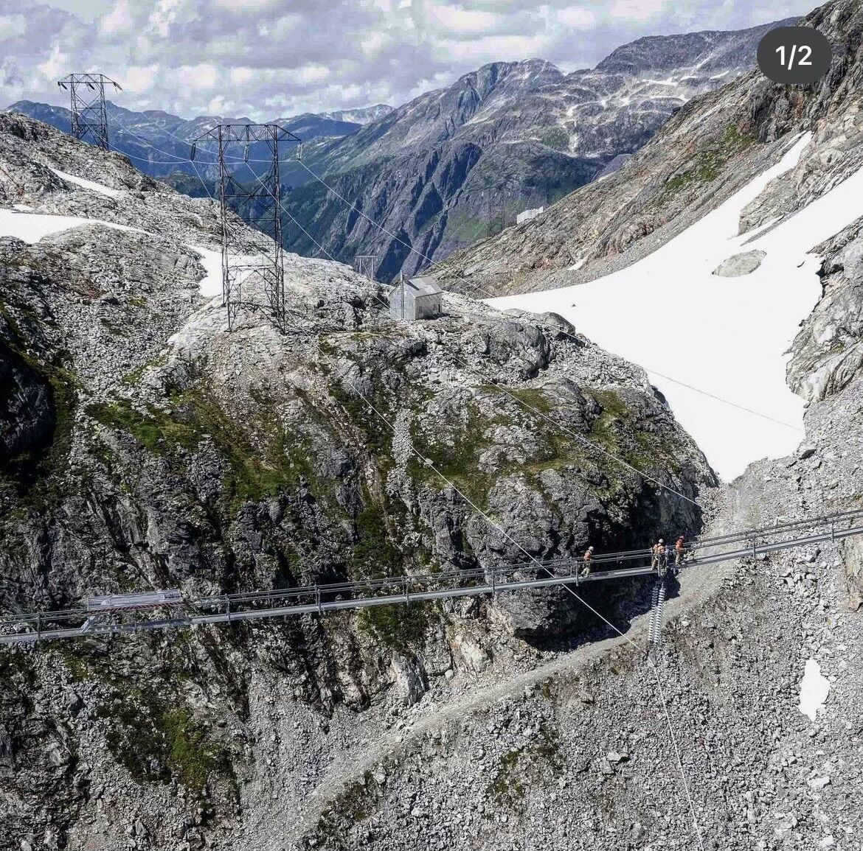
Nechako Reservoir / River / Freshet Information Sharing –
Community Leaders
08 May 2024
Prepared by Andrew Czornohalan
& Water Resources Group

Slide 2
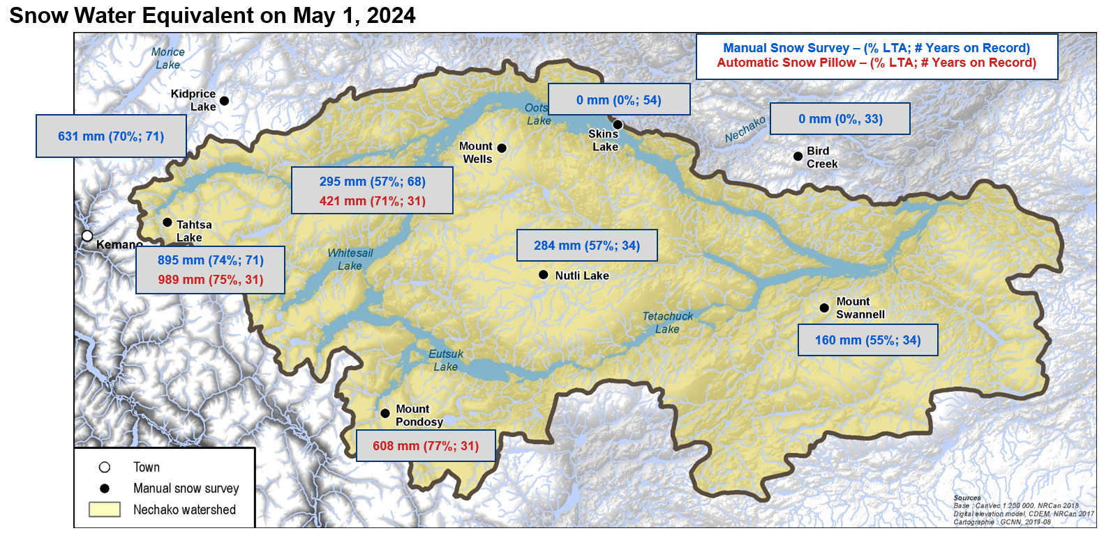
Current Snowpack

Slide 3
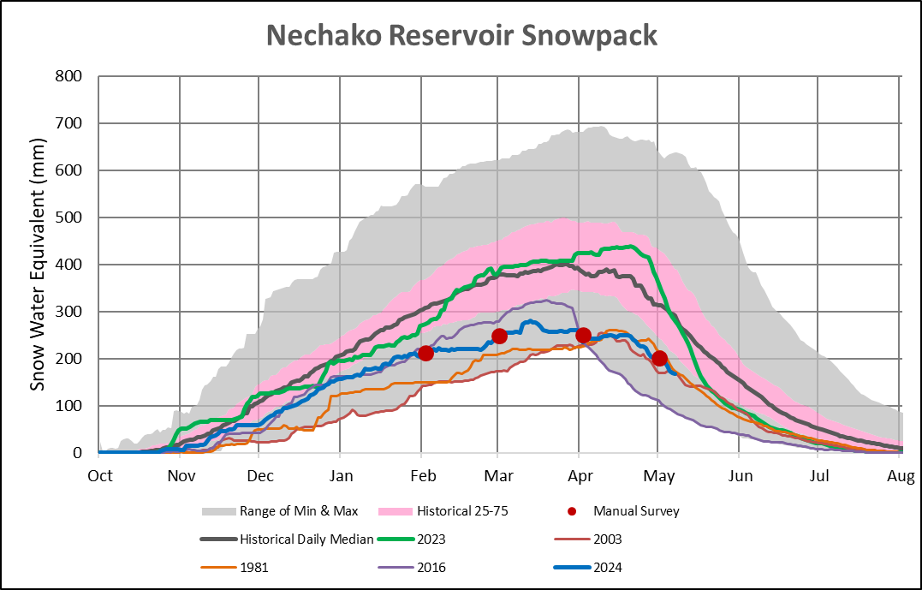
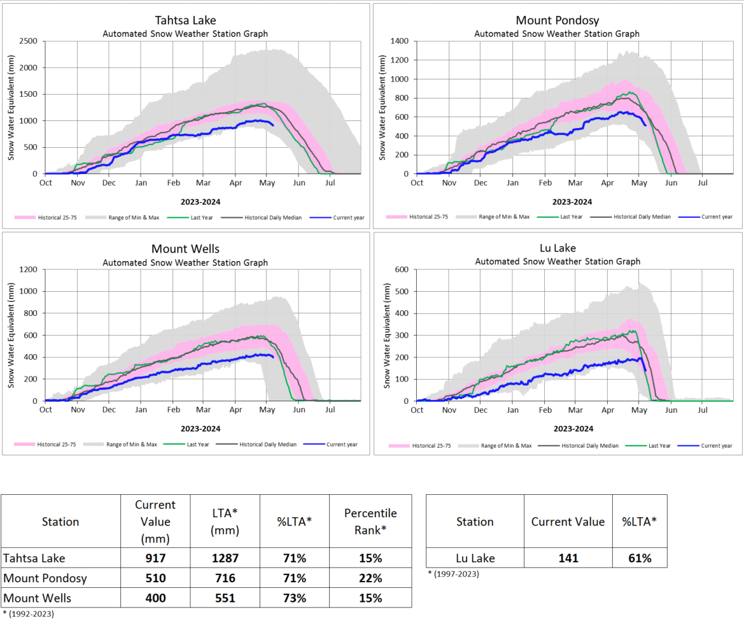
Current Snowpack
167 mm (54% LTA)
5th lowest in 66 years

Slide 4
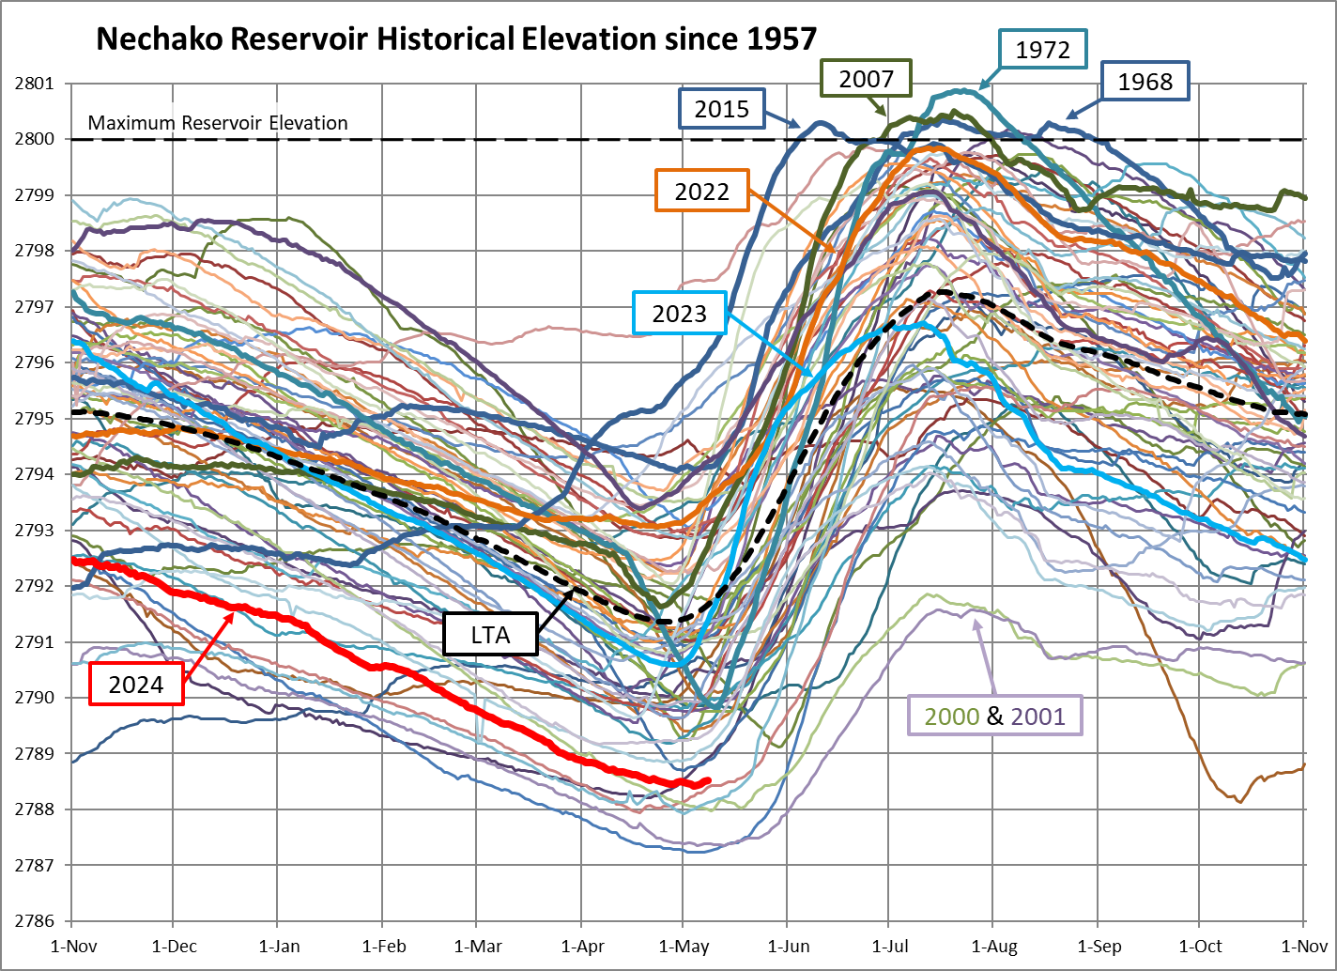
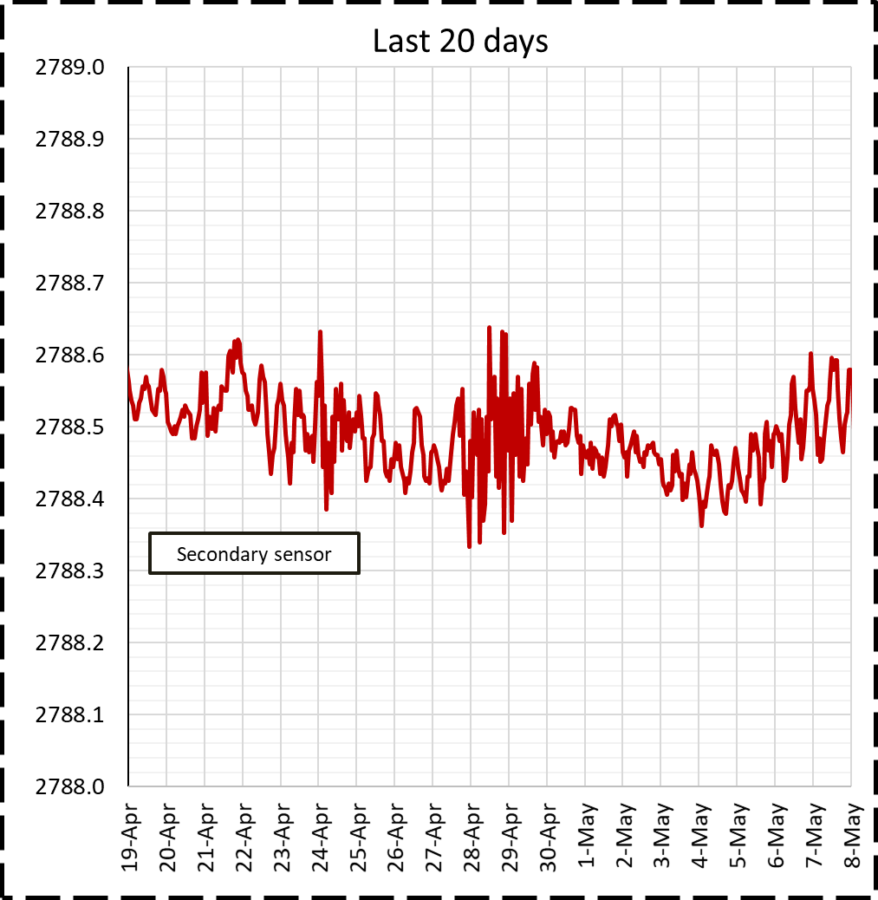
Reservoir Elevation - Last 20 days
Current reservoir level
2788.55 ft (Approx)

Slide 5
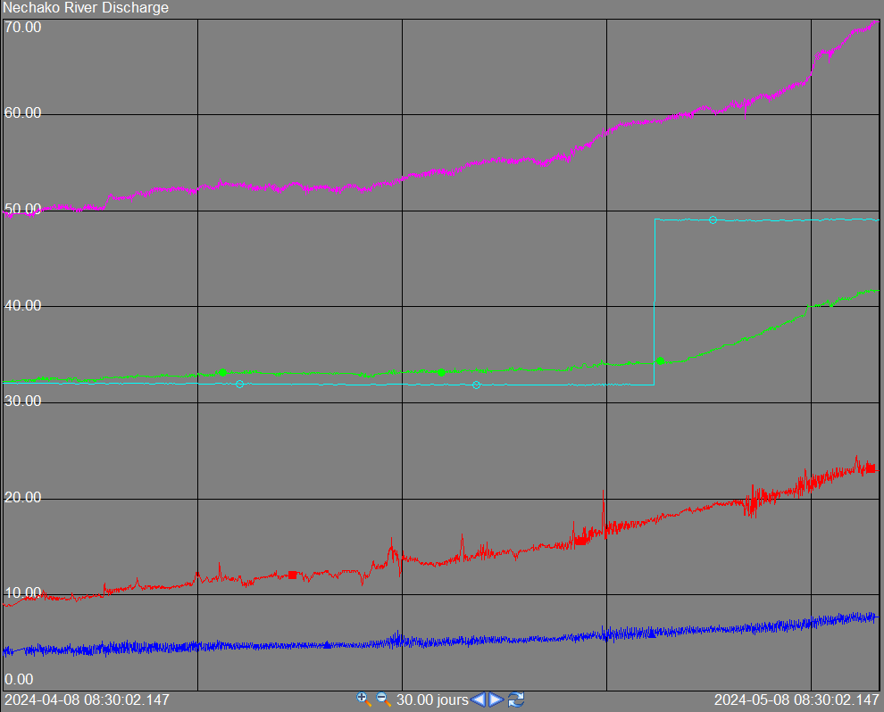
Flows - Last 30 days
Current values (m³/s)
Vanderhoof | 70
Skins Lake | 49
Cheslatta Falls | 42
Nautley | 23
Stellako | 8
Notes:
Keep in mind:
River Discharge measurements are estimated from water level,
Skins Lake Spillway discharge are estimated from gate opening.
Graphique dans: ProcessBook->Hydrological Data -> Kemano & Nechako River Discharge ->Nechako at Vanderhoof

Slide 6
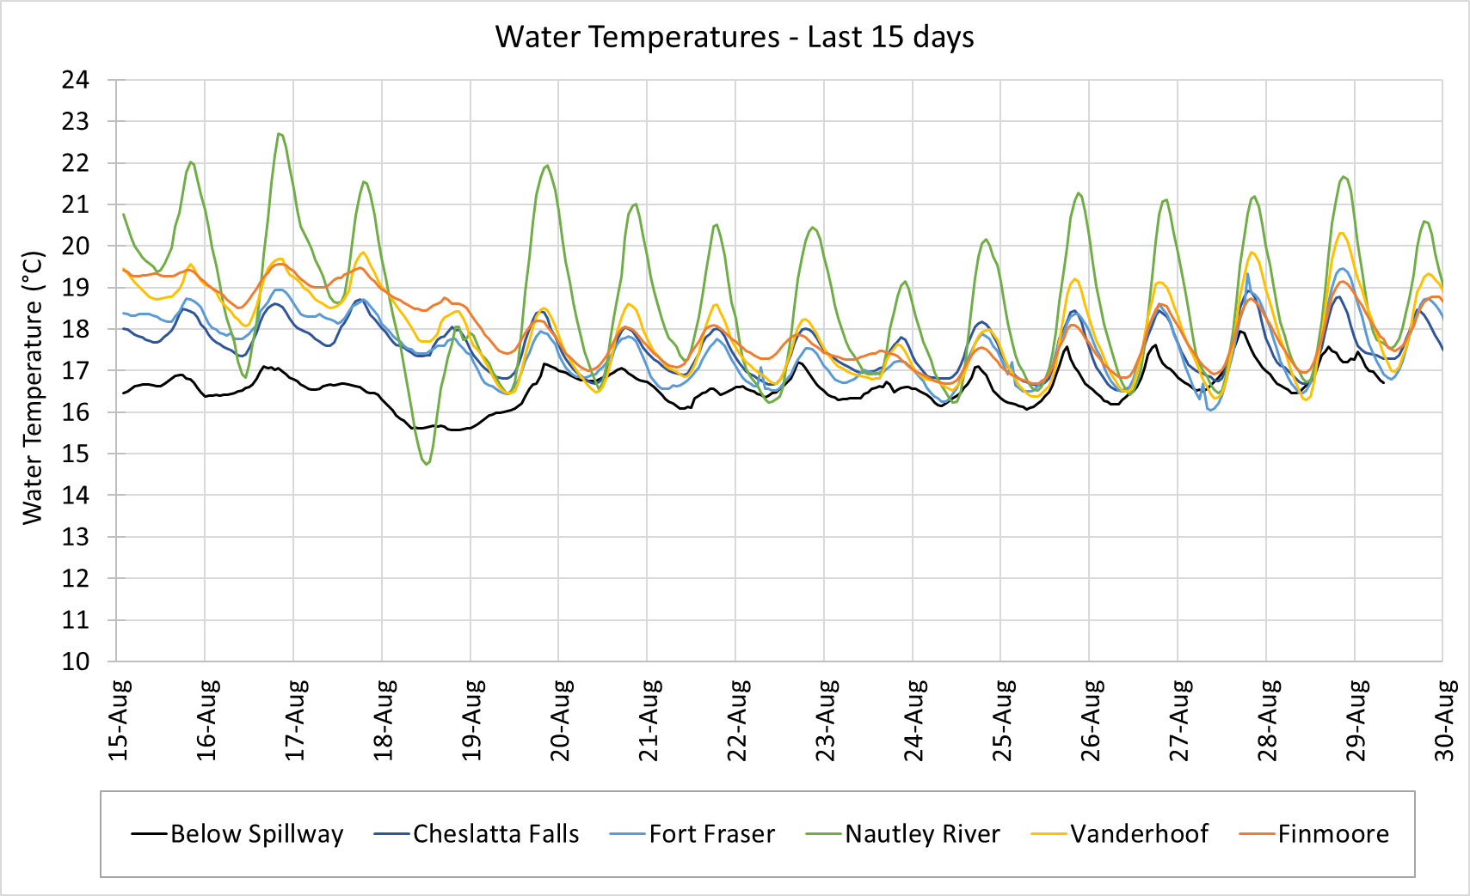
Observed Water Temperatures – Last 15 days
Average – Last 24h (°C)
Below spillway | 17.1
Cheslatta Falls | 17.7
Fort Fraser | 17.8
Nautley River | 18.8
Vanderhoof | 18.3
Finmoore | 18.2
Target : <20°C daily average at Finmoore

Slide 7
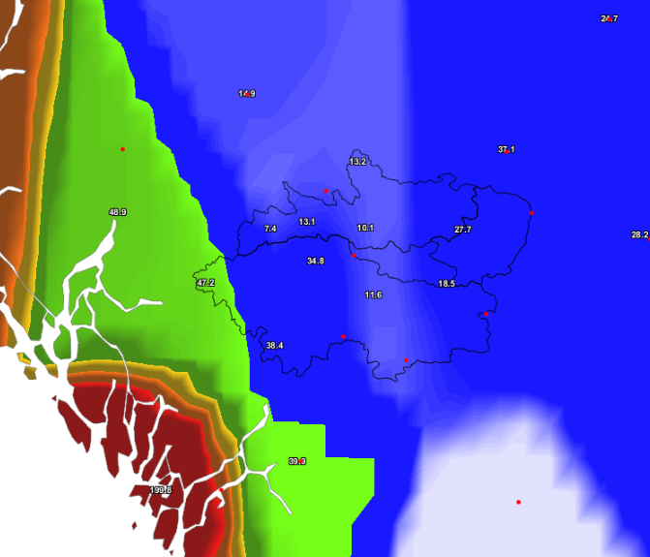
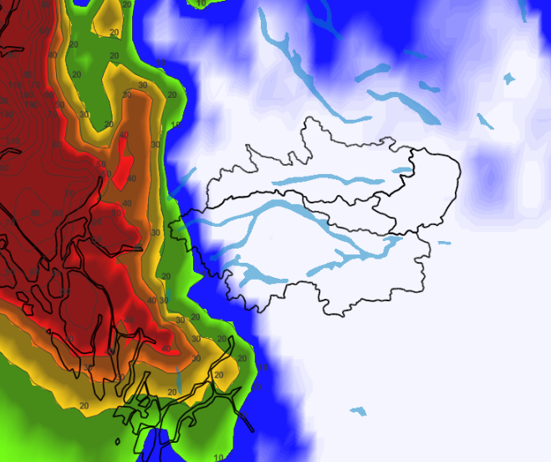
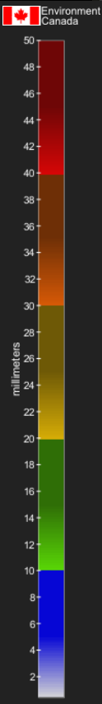

Past & Future total precipitation
Forecast (next 10 days)
Observation (last month)
Nechako Reservoir watershed area-average = 25 mm
Historical Average = 47 mm
Nechako Reservoir watershed area-average = 5-20 mm

Slide 8
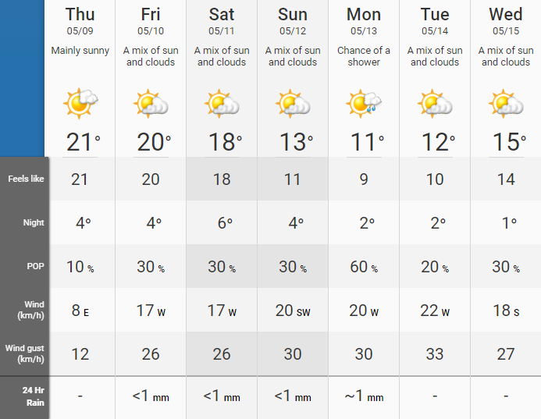
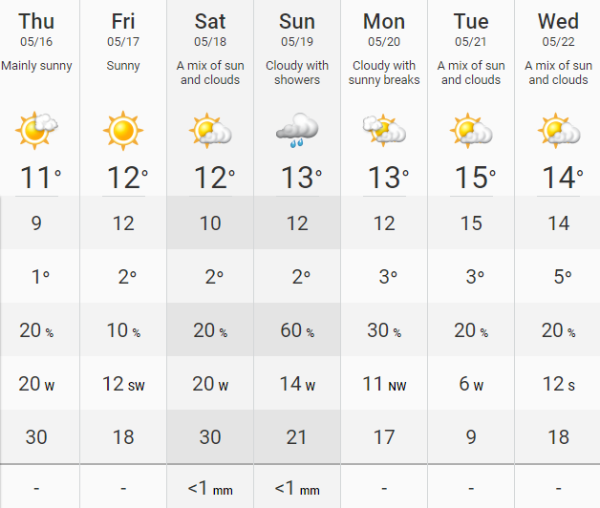
Weather Forecast
Marilla Weather

Slide 9
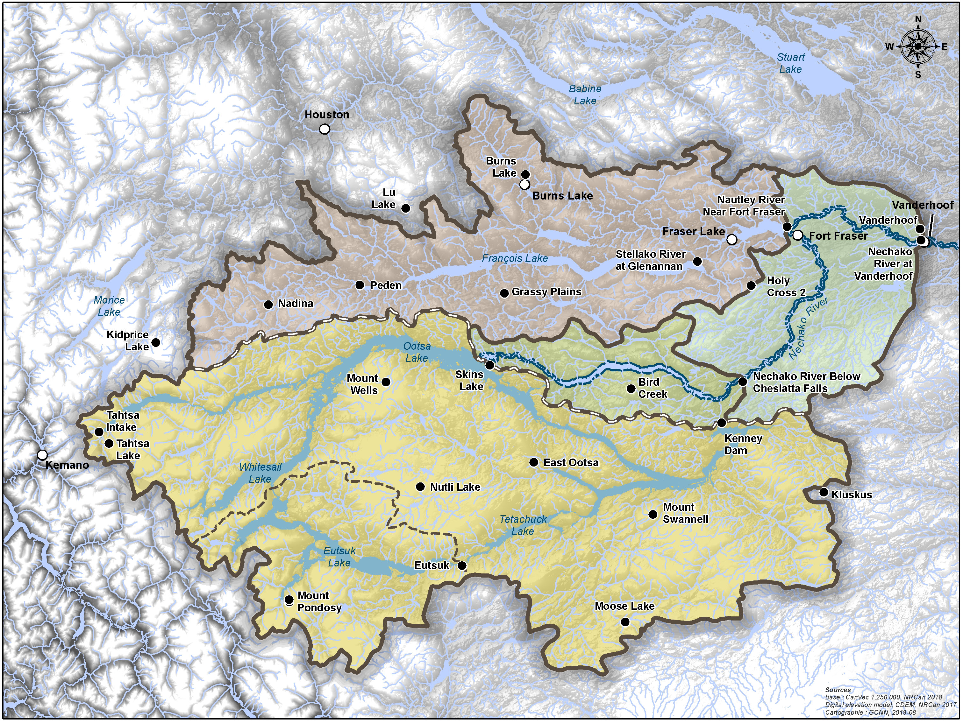
Weather Forecast*
Burns Lake Weather
McDonalds Landing
Streatham
Baptiste Louis 8
Marilla
Targe Creek
Leon 14
*Possible Weather Stations
Nechako Reservoir
Kemano
Streatham
Marilla
Leon 14
Nechako River
Vanderhoof
Cheslatta
Baptiste Louis 8
Targe Creek
Nautley
McDonalds Landing
Burns Lake
Fraser Lake

Slide 10
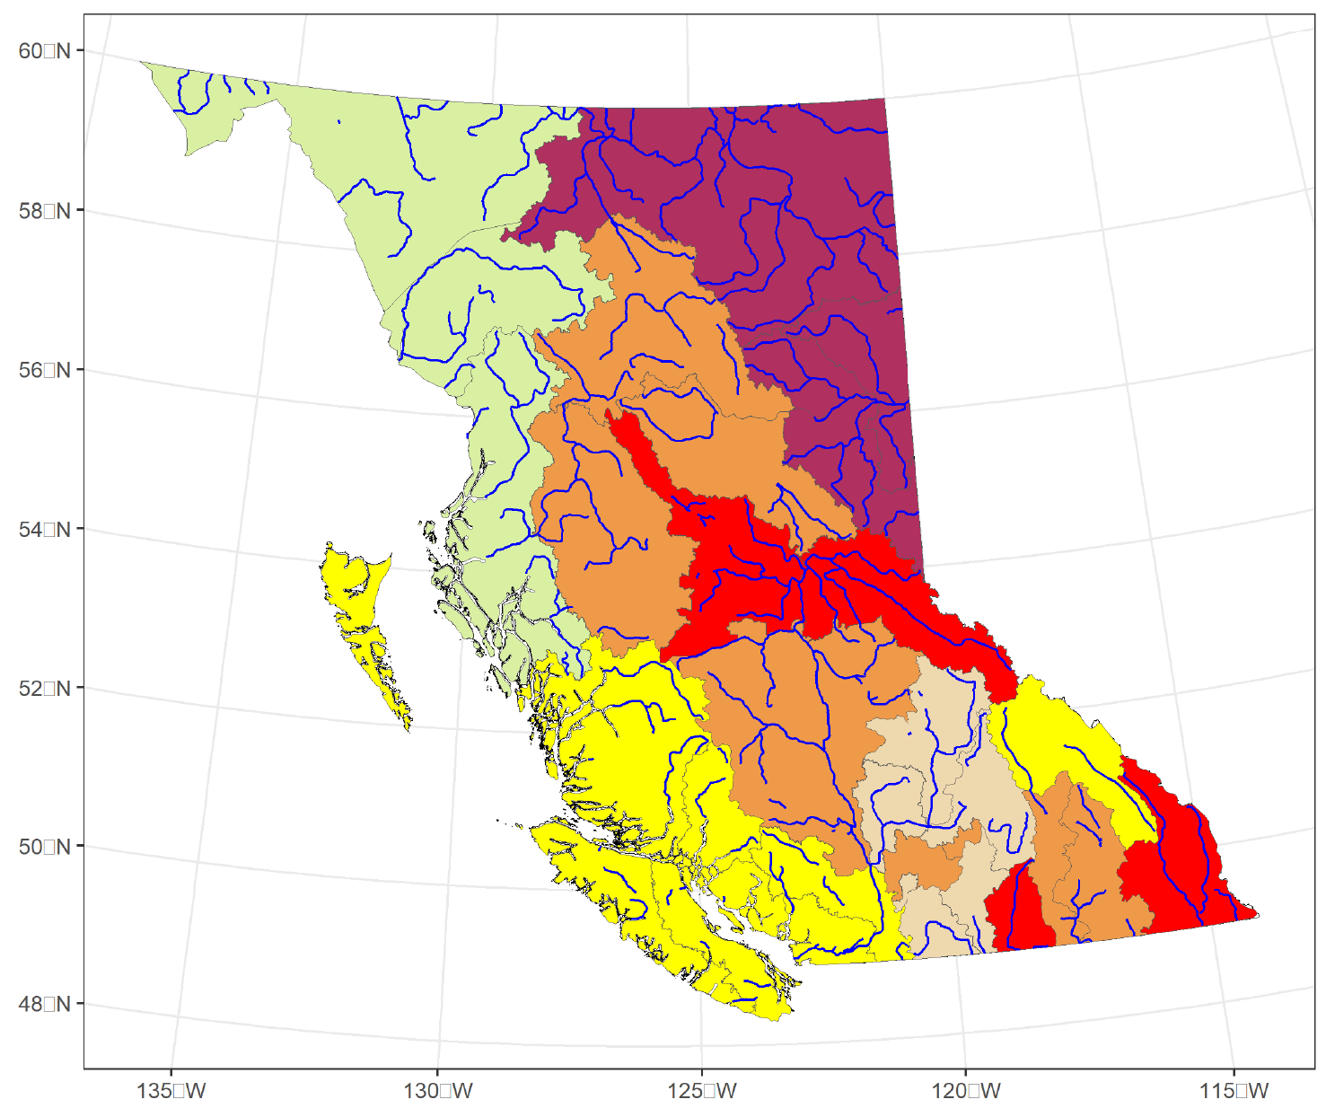
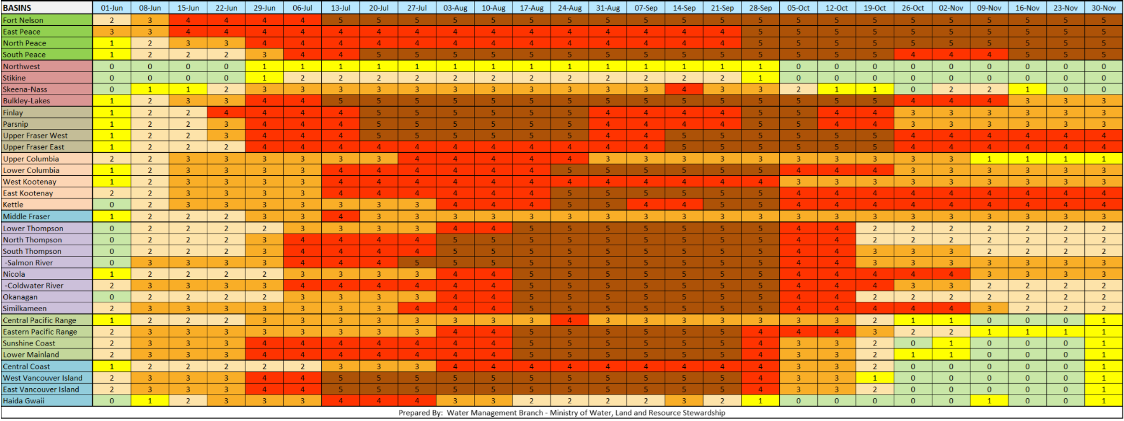
Provincial Advisories - Drought
Last updated : 30-Nov.
Drought Level 3 : Adverse Impacts Possible
Drought updates have concluded for the 2023 season and will resume in spring 2024.
North Lucas Lake
Tatuk Lake
Wide Basins & Imperfect borders
The Stellako River : Upper Fraser West (level 4)
Western portions of Burkley Lakes saw higher flows
Several indicators are factored : see Plan.
Source: British Columbia Drought Information Portal
Water Management Branch – Ministry of Forests
British Columbia Drought and Water Scarcity Response Plan (gov.bc.ca)
https://www2.gov.bc.ca/assets/gov/environment/air-land-water/water/drought-info/drought_response_plan_final.pdf
Notes:
drought levels are a general condition across what are quite often large basins
the borders of these basins are imperfect
The Stellako River, which drains into Francois Lake) has a hydrometric station at Glenannan, which is located in the Upper Fraser West basin.
During the month of November, the areas in the western portion of the Bulkley-Lakes Basin were experiencing higher flows

Slide 11
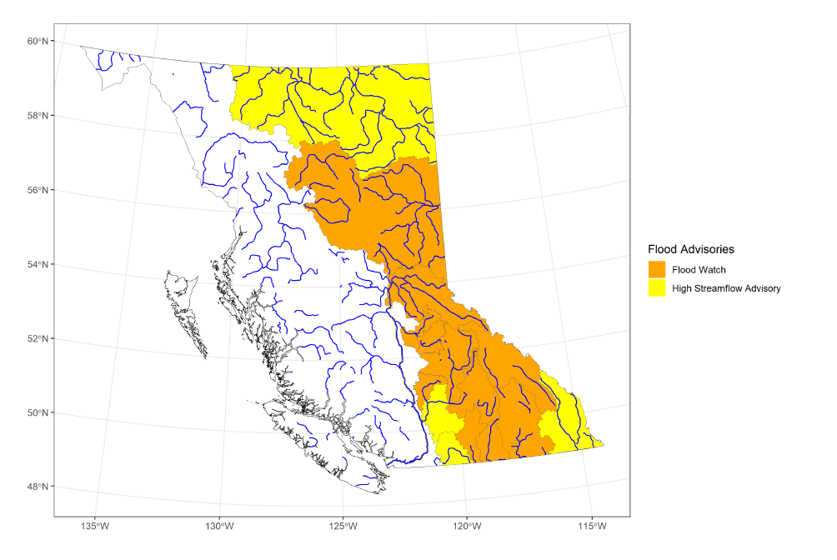
Provincial Advisories - Flood
Last updated : May 23th 2023
Source: BC River Forecast Center.

Slide 12
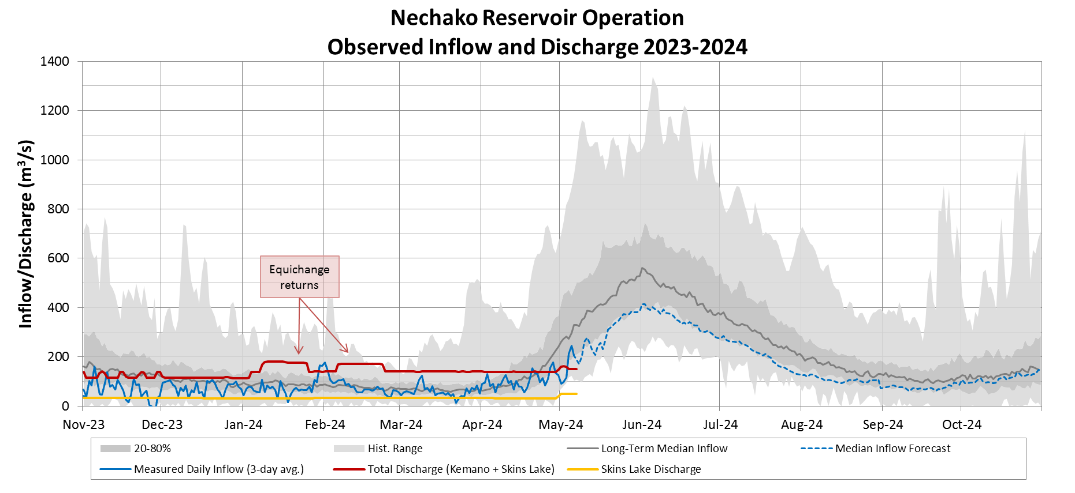
Observed Inflows & Discharge vs Historical

Slide 13
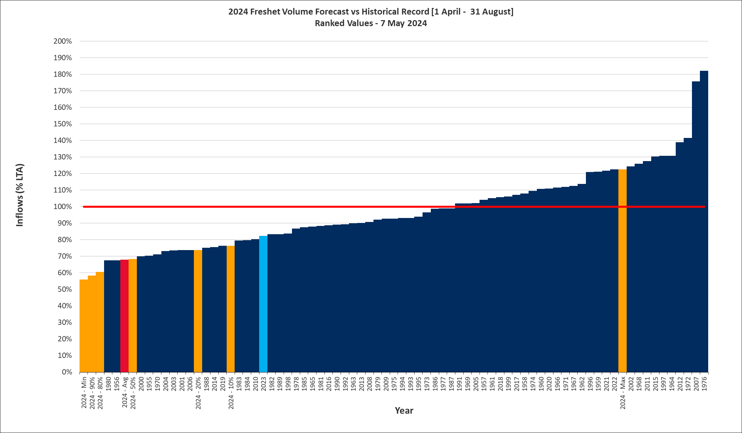
Spring Freshet Inflow Volume Forecast
Historical Record of Observed Volumes
Forecast Volume Exceedance Probability
Forecast Volume Average
68% LTA
2021 & 2022
Last year
68% LTA

Slide 14
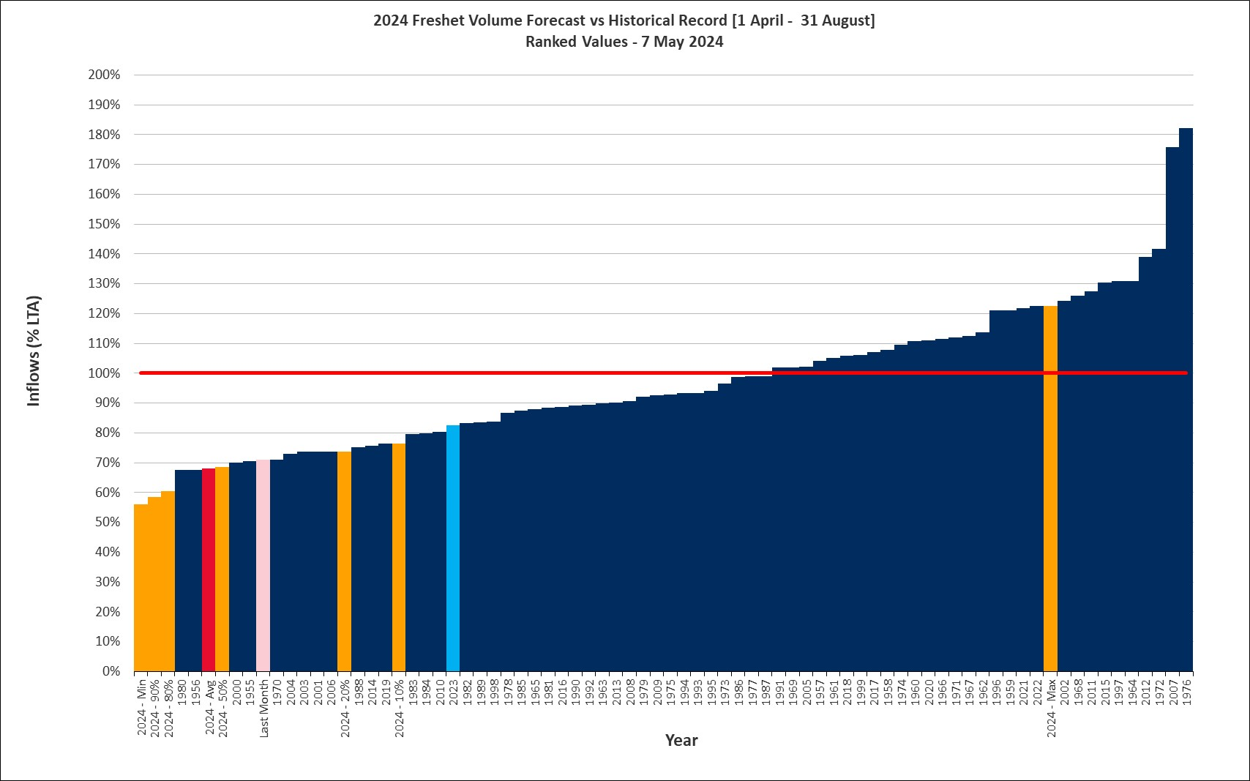
Spring Freshet Inflow Volume Forecast
Historical Record of Observed Volumes
Forecast Volume Exceedance Probability
Forecast Volume Average
Last month 71% LTA
2021 & 2022
Last year
68% LTA

Slide 15
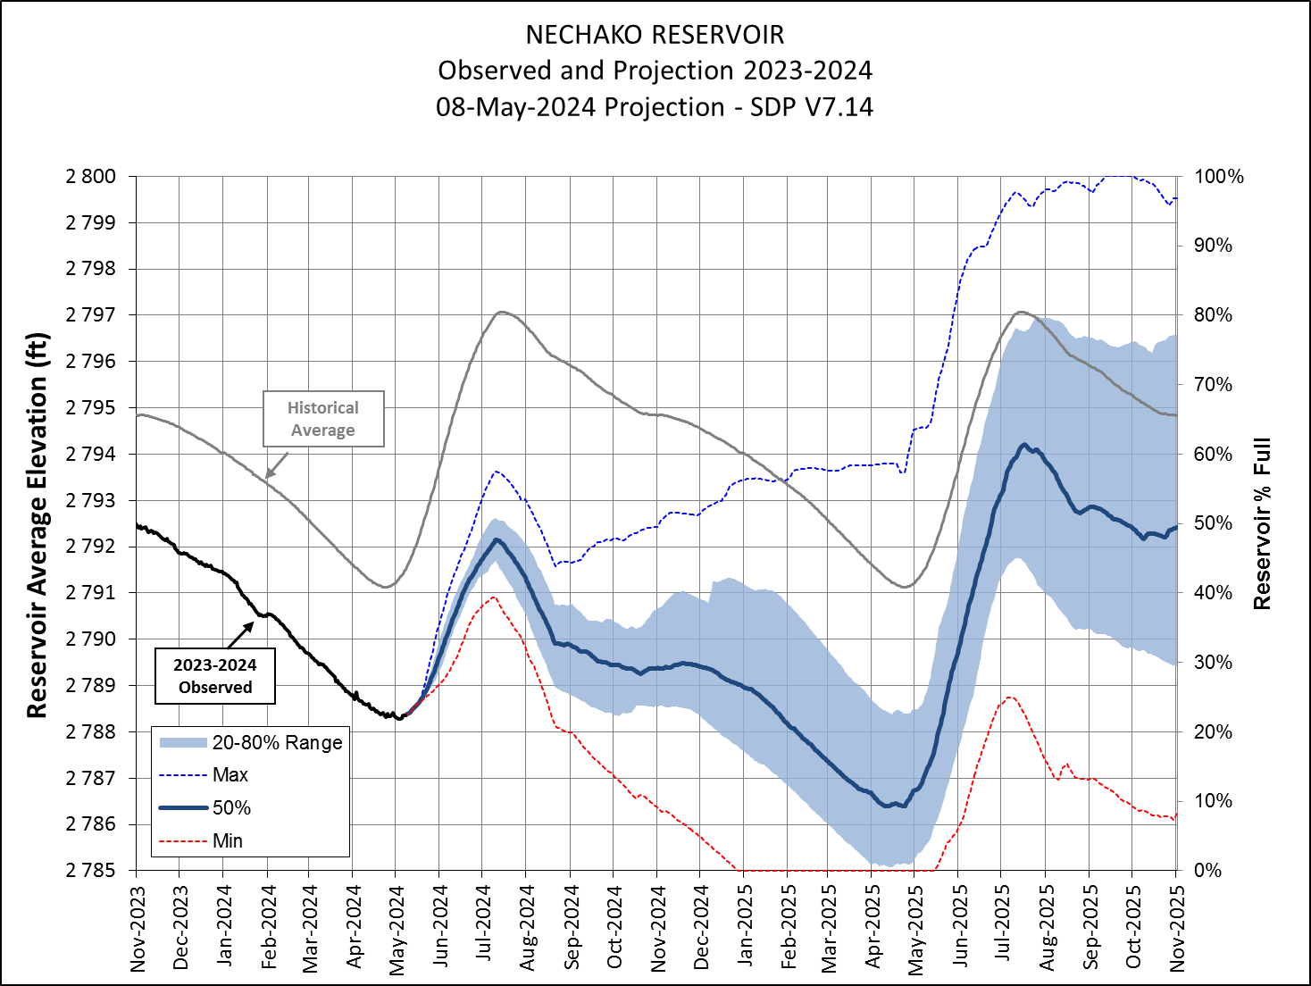
Reservoir Level Projection

Slide 16
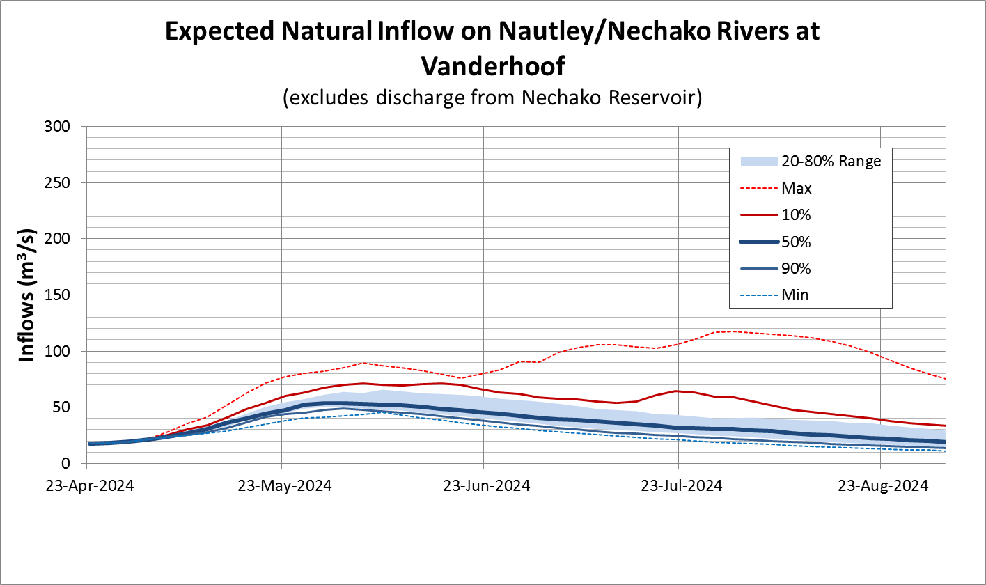
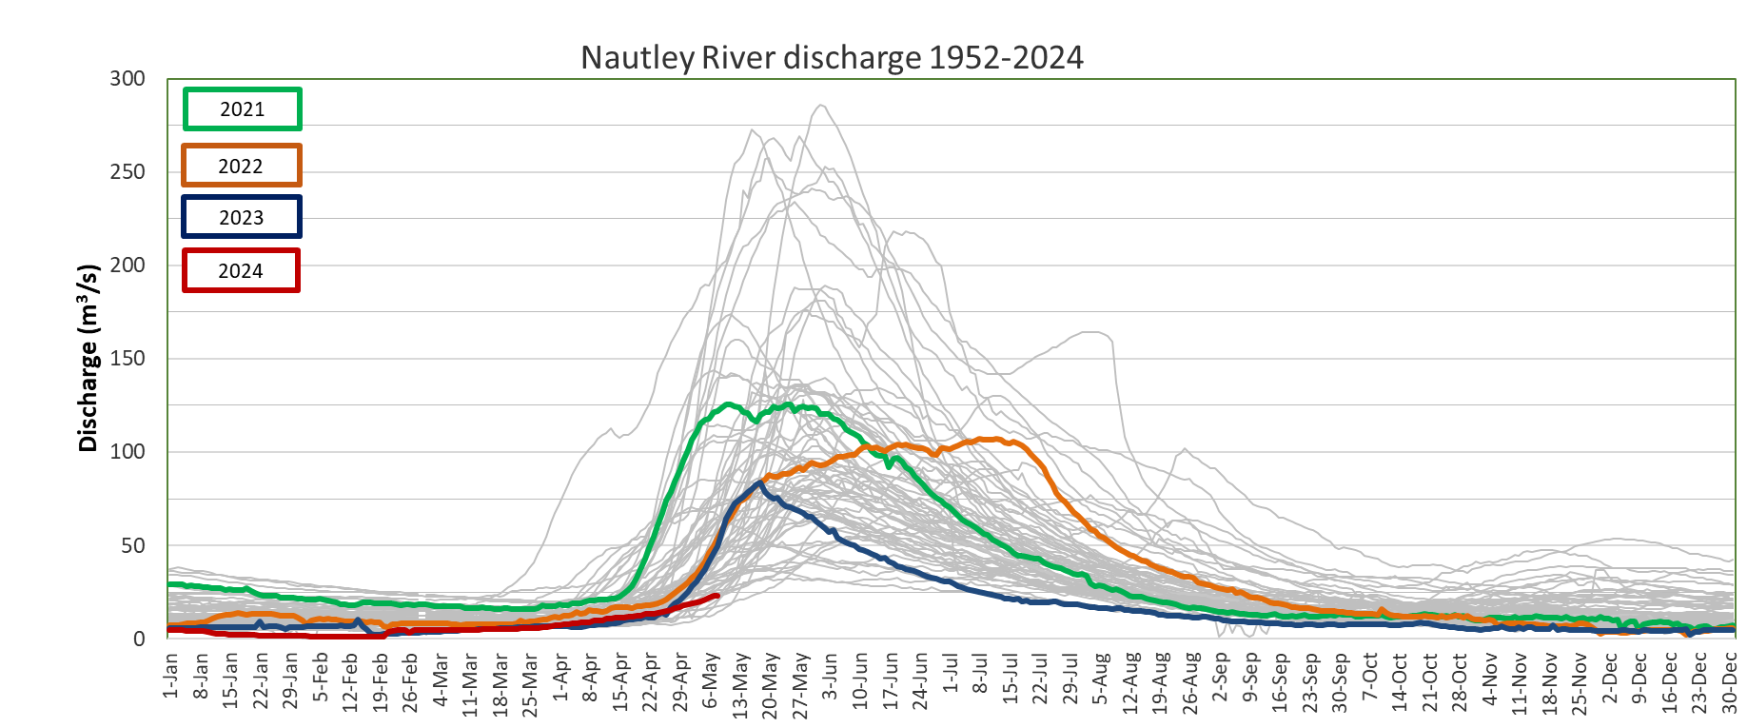
Nautley River Flows, Forecast
Notes:
Spike on natural inflows (max) Is 2007.

Slide 17
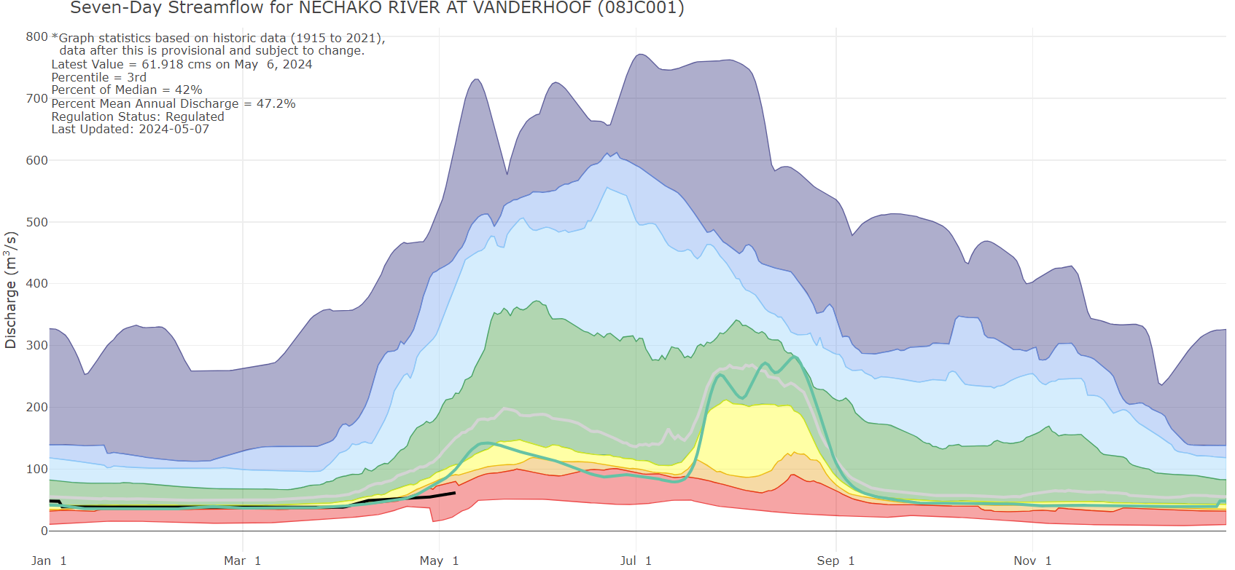
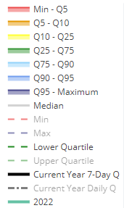
Vanderhoof
Source: 08JC001 NECHAKO RIVER AT VANDERHOOF (gov.bc.ca)

Slide 18
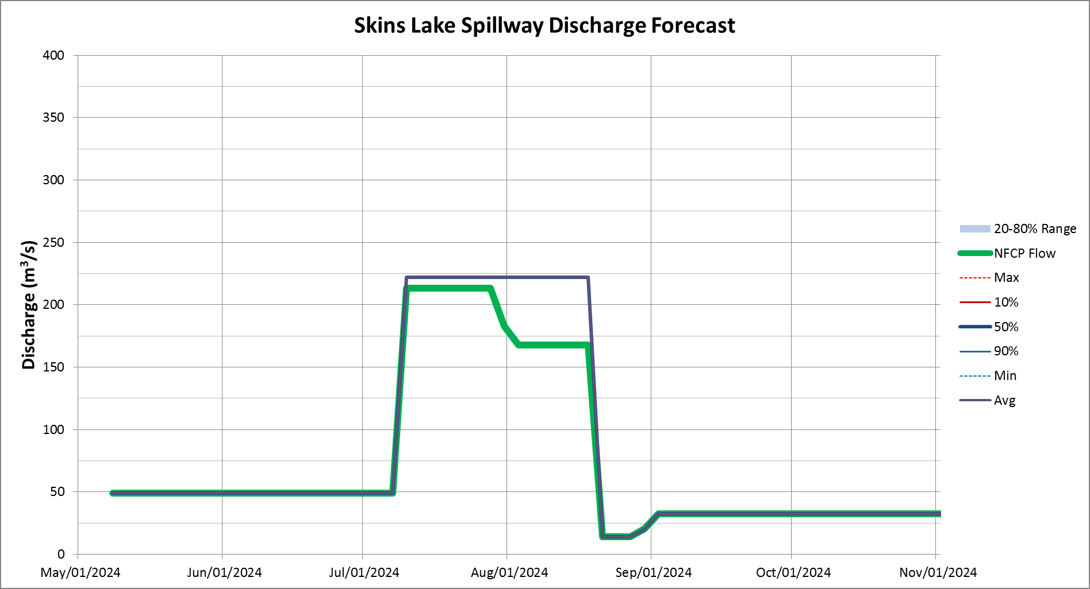
Skins Lake Spillway Release - Forecast
Current release = 49 m³/s

Slide 19
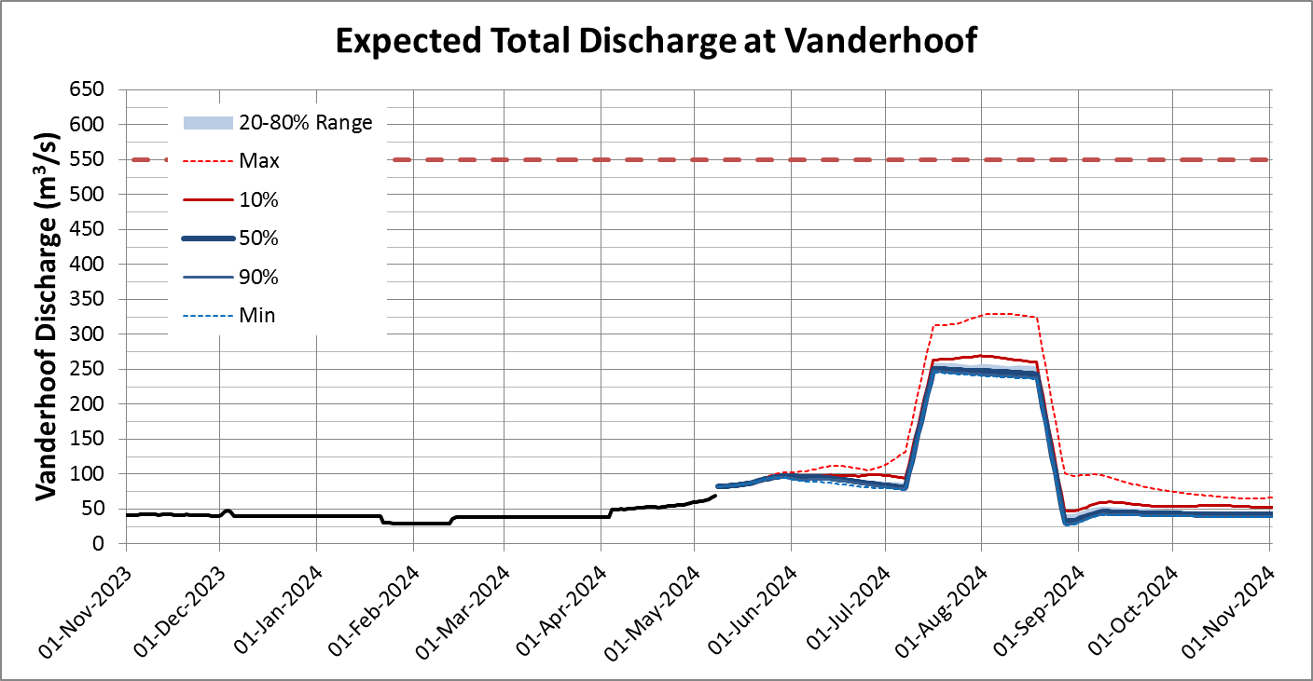
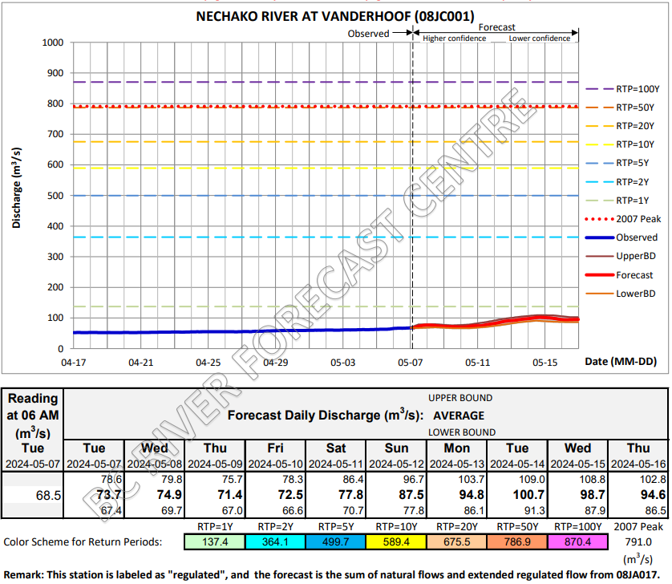
Forecast – Vanderhoof
Source : RFC's Clever model - 08JC001.PDF(gov.bc.ca)

Slide 20
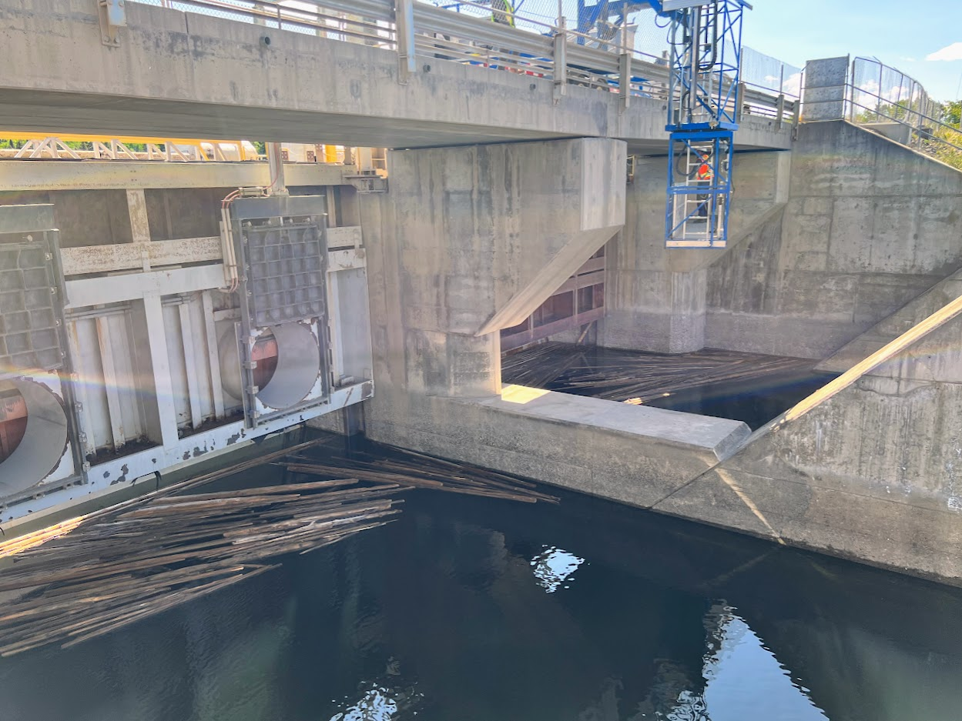
Updates - Next Steps – Actions
Confirm next meeting date & time
– Propose April 30th
Work with BC Hydro to manage the drought and energy balance for the winter
Report out Dam Safety Review and Dam Emergency Plan once updated in Spring
Presentations are available on the Get Involved Nechako website under 'Our Operations'. Recordings can be requested up to 30 days following the meeting.

Slide 21
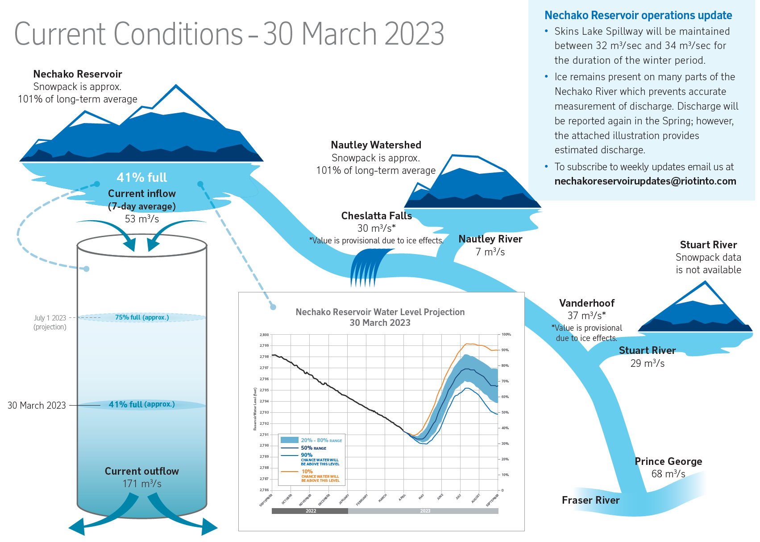
Flow facts of last Thursday

Slide 22
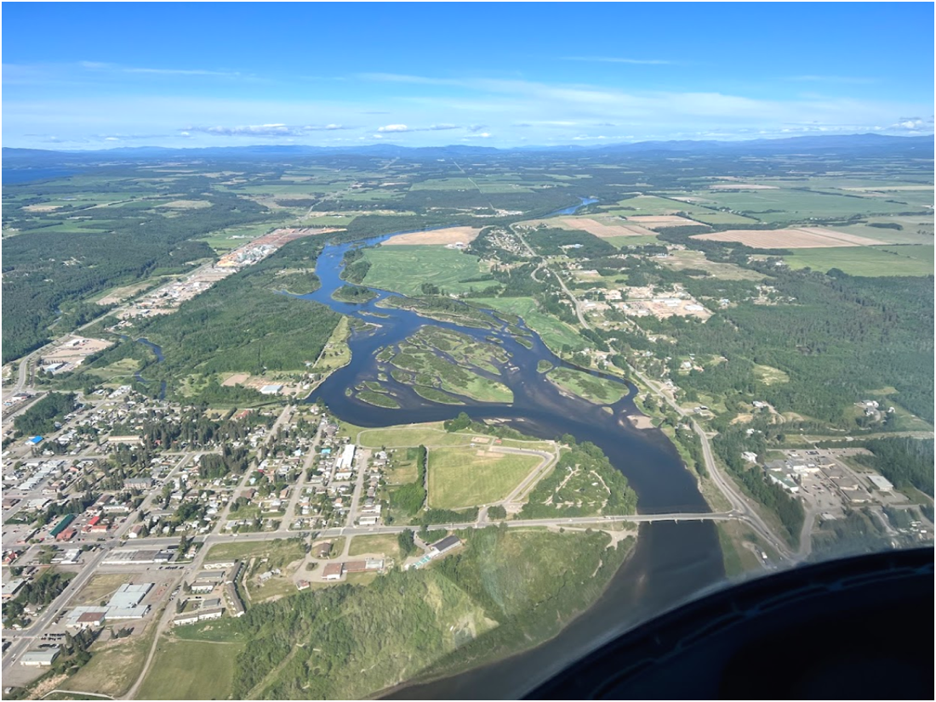
Feedback & Reflections

